Slide 1
NAHRI Illinois Local Chapter Presents: Outpatient Clinical Documentation Integrity
February 18, 2021

Slide 2


NAHRI Local Chapters
NAHRI endorses the formation of regional, state, local, and subject-specific networking organizations. NAHRI encourages the collaboration of such groups with the national body and supports the alliance of the local and national groups for mutually favorable principles.
New chapters include the NAHRI Illinois Local Chapter and the Pacific Northwest Regional Chapter (AK, OR, WA).
Interested in joining or starting a new chapter? Visit nahri.org/local-chapters or email NAHRI Associate Editor Kevin Duffy at kduffy@hcpro.com

Slide 3
Agenda
Illinois Chapter Leader introductions
Illinois geography and population
Illinois hospital statistics
Illinois Chapter goals
Education presentation from Phil Kajpust and Stacey Brennert

Slide 4
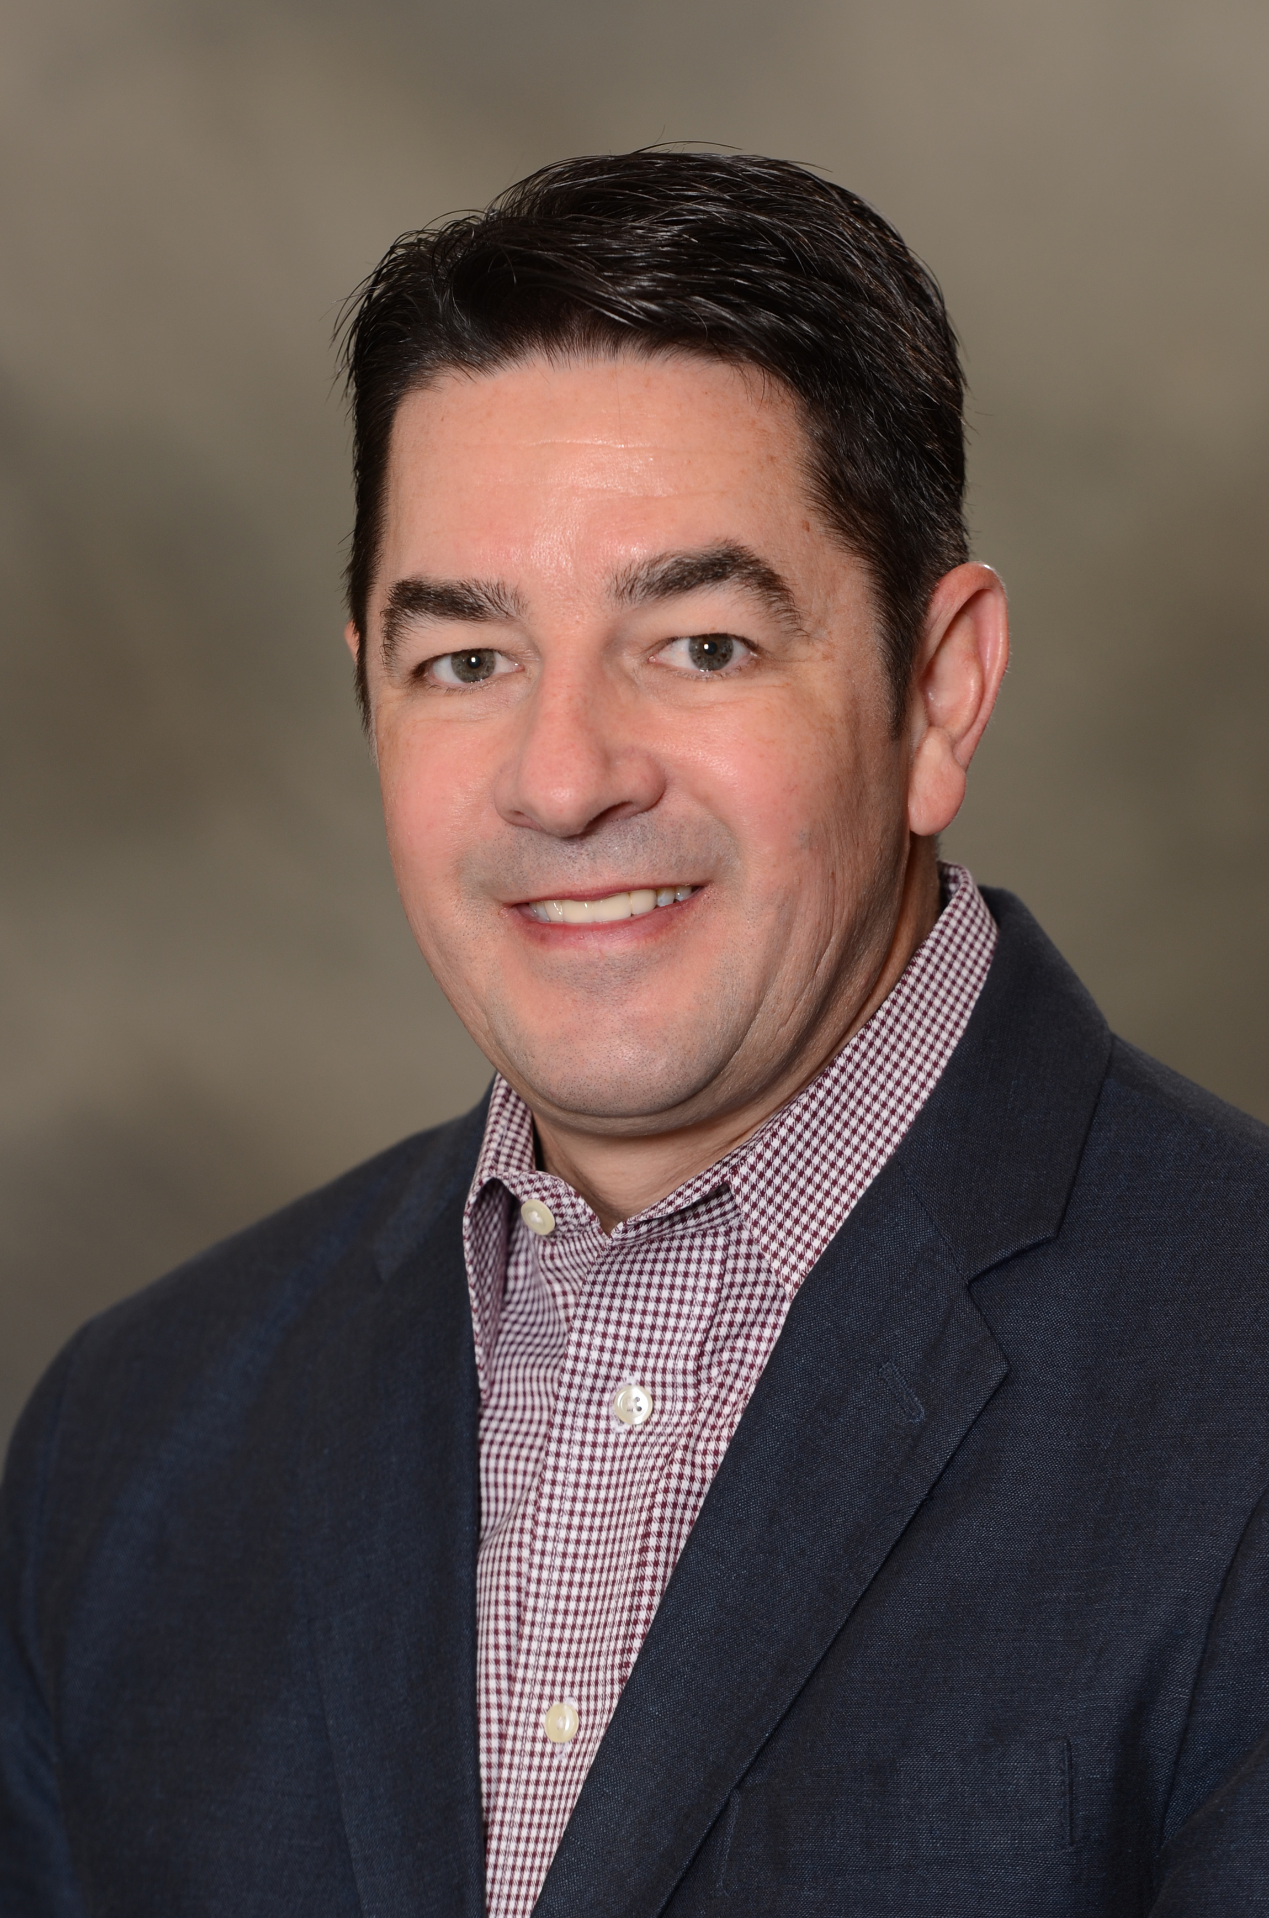
Founding Chapter President
Jeff Morgan, FHFMA, CHAM, Senior Sales Manager, Craneware, Chicago
Morgan has more than 20 years of healthcare revenue cycle and revenue integrity experience as senior sales manager with Craneware. He is a Certified Healthcare Financial Professional (CHFP), and a Fellow within Healthcare Financial Management Association (HFMA). Morgan is also a Certified Healthcare Access Manager, as certified by the National Association of Healthcare Access Managers (NAHAM). He holds a Bachelor’s Degree in Business Administration, Finance, from Appalachian State University.
Morgan has been a member of HFMA for 15 years and served as the president of the Greater St. Louis HFMA Chapter from 2017–2018. He is a founding member and president of the Illinois Chapter of NAHRI.

Slide 5
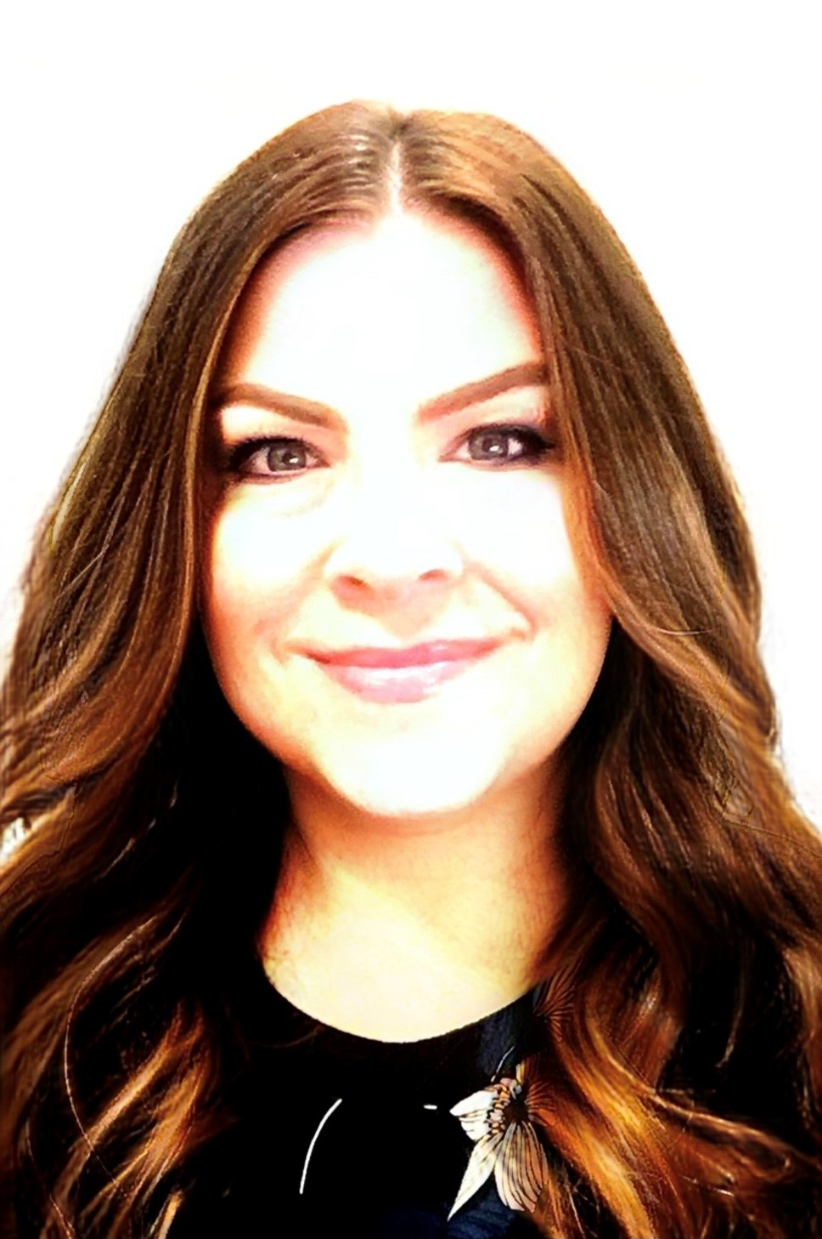
Founding Board Member
Alison Davis, CPC, CEMC, Manager, Business Office Operations, Carle Foundation Hospital, Urbana, IL
Davis is a healthcare revenue cycle professional with more than 27 years of experience focused in professional and facility coding and billing, accounts receivable, and large health system charge capture and chargemaster structure management. \ She maintains certification as a Certified Professional Coder (CPC), Certified Evaluation and Management Coder (CEMC), and Epic Resolute Hospital Billing Charge Capture and CDM.
Davis transitioned multiple physician and hospital entity chargemaster structures onto the Epic platform, as well as health system ambulatory locations from a physician office model to provider-based outpatient departments of the hospital. She implemented strategic pricing models in a large health system, as well as integration of HIM, billing, pharmacy, supply chain, compliance, and IT into a system wide standardized CDM management team. She has managed charging and receivables for physician practices, academic hospitals, rural health clinics and critical access hospitals.
Davis specializes in managing charge capture controls and automation across the EMR and practice management system platforms to ensure appropriate and full charge capture and billing accuracy balancing CMS regulations, AMA CPT® guidelines, and third-party payor policies.

Slide 6
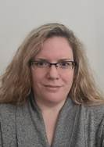
Founding Board Member
Bess Quint, Senior Revenue Integrity Analyst, Northwestern Medicine, Warrenville, IL
Quint is a senior revenue integrity analyst with Northwestern Medicine. She has more than 12 years of experience in the healthcare revenue cycle with community-based health systems and large regional academic healthcare systems. She has experience in facility insurance verification, financial counseling, collections, and billing.
For the last six years, Quint has been working in revenue integrity focused on charge capture and CDM. She maintains both a Certified Healthcare Financial Professional (CHFP) Certification and a Certified Revenue Cycle Representative (CRCR) Certification through HFMA.
Additionally, Quint an maintains Epic Hospital Billing and Charging Administration Certificate, Epic Beaker Clinical Pathology Certification, and Epic Clinical Anatomic Pathology Certification. She holds a Bachelor in Business Administration with a concentration in Healthcare Administration from Southern New Hampshire University.

Slide 7
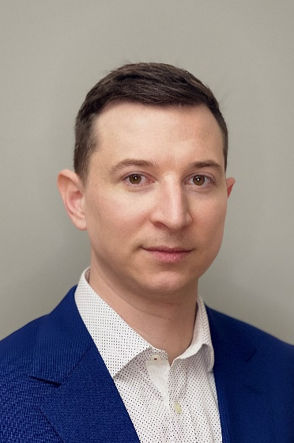
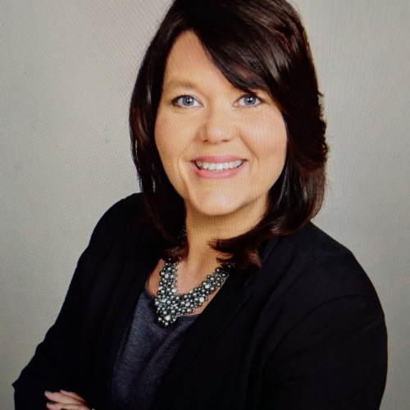
Founding Members
Phil Kajpust, RHIA, Manager Revenue Integrity, NorthShore University HealthSystem, Skokie, IL
Nicole Robinson, BS, MJ, MBA, CRCR, RHIA, VP- Patient Access and Mid-Revenue Cycle, OSF Healthcare, Peoria, IL
Holly Pogioli, Revenue Integrity Manager, OSF Healthcare, Peoria, IL

Slide 8
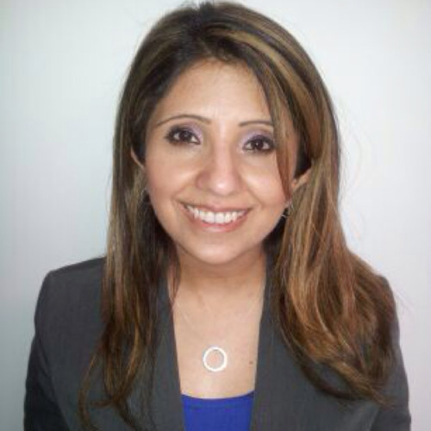
Founding Members
Arshia Aslam, Manager, Finance Department, Revenue Integrity,
Northwestern Medicine, Warrenville, IL
Gabriella Zdun, Director, Finance Department, Revenue Integrity,
Northwestern Medicine, Warrenville, IL

Slide 9
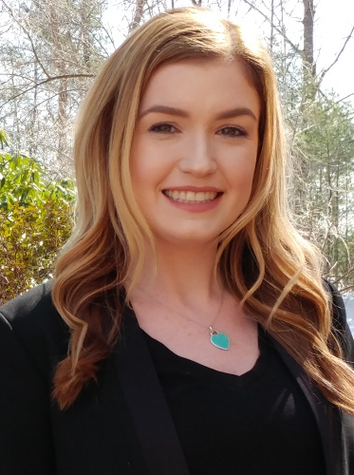
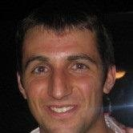
NAHRI Leadership
Jaclyn Fitzgerald, Director of NAHRI
jfitzgerald@hcpro.com
Kevin Duffy, Associate Content Specialist
kduffy@hcpro.com

Slide 10
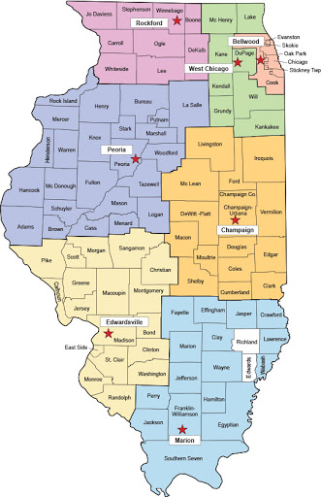
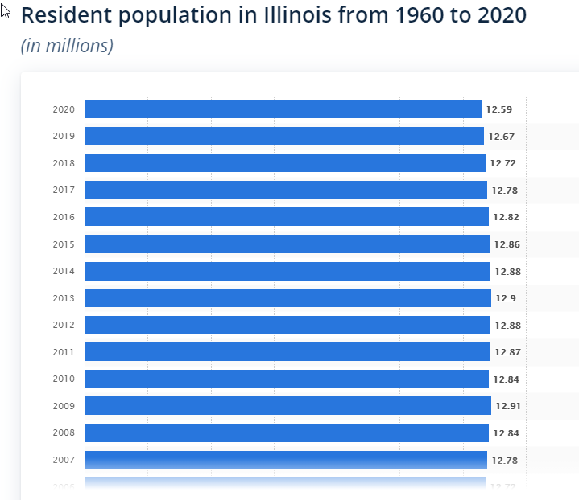
Illinois Statistics

Slide 11
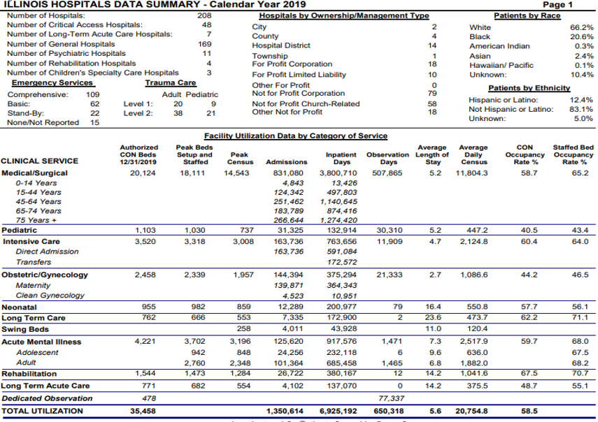
Illinois Hospital Statistics
Illinois (excluding Cook County)
Beds
  10,759
ICU Beds
  1,579
Illinois Total
Beds
  20,987
ICU Beds
  3,535

Slide 12
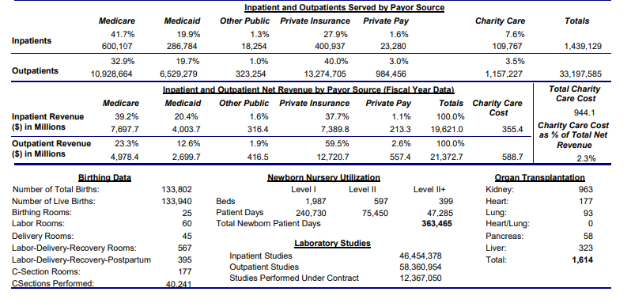
Illinois Hospital Statistics

Slide 13
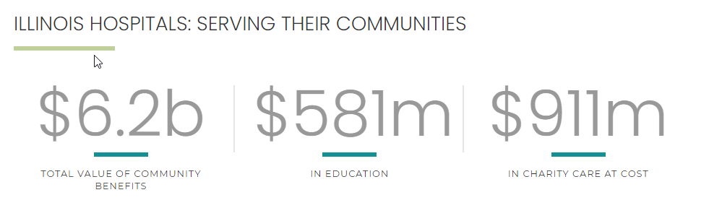
Illinois Hospital Statistics

Slide 14
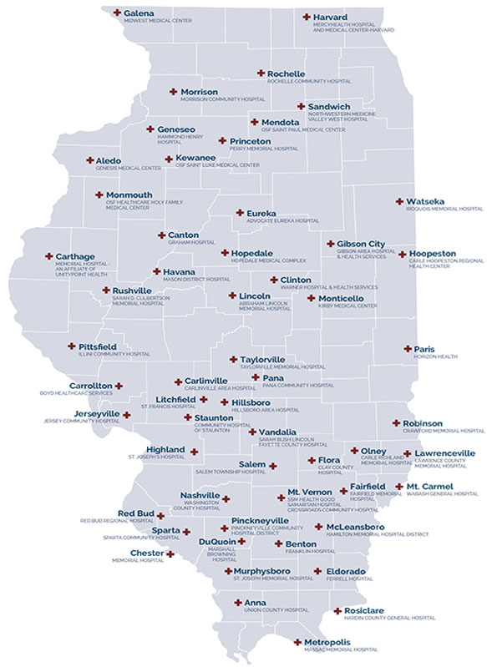

Illinois Hospital Statistics: Critical Access Hospitals
https://www.google.com/url?sa=i&url=https%3A%2F%2Fwww.freepik.com%2Fpremium-photo%2Fnumber-48_4362871.htm&psig=AOvVaw2kDER6dQpYgQKHnx3GrqjX&ust=1613602652139000&source=images&cd=vfe&ved=0CAIQjRxqFwoTCND--vzA7-4CFQAAAAAdAAAAABAJ

Slide 15
Illinois Chapter Goals
Become the networking community for revenue integrity professionals throughout Illinois
Provide relevant and timely education to all members
Provide Illinois revenue integrity professionals an organization to become leaders in, to further advance careers
Work with a broad cross-section of stakeholders to improve the healthcare delivery by identifying, addressing, and bridging gaps in knowledge, best practices, and standards

Slide 16
Outpatient Clinical Documentation Integrity

Slide 17

Guest Speaker
Phil Kajpust, RHIA, Manager Revenue Integrity, NorthShore University HealthSystem, Skokie, IL
Kajpust has 15 years experience working in healthcare filling roles in operations and the revenue cycle. He holds a Masters Degree in Health Administration from Valparaiso University and is a Registered Health Information Administrator (RHIA). Currently he is the revenue integrity manager at NorthShore. Working in what was previously known as coding billing operations, Kajpust formally organized and introduced revenue integrity to NorthShore, partnering with HIM, CDM, and other revenue cycle departments, and expanding revenue integrity to include clinical staff and specialized coding and compliance roles.

Slide 18
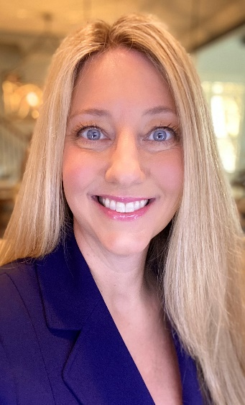
Guest Speaker
Stacey Brennert, BSN, RN, COC, CIRCC, CHRI, Senior Manager, Claro Healthcare, Chicago
Sbrennert@Clarohealthcare.com
Brennert is a senior clinical manager for Claro Healthcare’s outpatient CDI practice. As a healthcare leader and consultant for more than 25 years, she is a deeply experienced professional nurse with an extensive background in hospital revenue cycle, including revenue integrity, compliance, outpatient coding, charge capture, and clinical staff education.
Brennert successfully works with leadership, clinicians, and coding staff at large academic and community-based hospitals across the United States, focused on clinical documentation improvement to support coding and charging. She worked to develop and implement outpatient facility clinical documentation improvement programs, providing education and support to hospital clinical staff and coding teams. She is well versed in developing tools for the facility’s ongoing success.
Brennert’s nursing experience prior to facility outpatient CDI includes medical/surgical nursing, surgical first assist for open heart surgery, clinical educator, nurse consultant responsible for high-cost drug and implant carve out reviews, DRG outlier payment validation, and medical necessary service verification. She held hospital leadership roles in the cardiac catheterization lab and revenue integrity. Brennert holds a Diploma of Nursing from the Lancaster General Hospital School of Nursing and Bachelor of Science in Nursing from Walden University. She is a certified outpatient and interventional radiology cardiovascular coder through AAPC. Additionally, she is certified in Healthcare Revenue Integrity by NAHRI.

Slide 19
Presentation Agenda
Outpatient clinical documentation integrity introduction and discussion objectives
Outpatient (OP) CDI overview and its relationship to revenue integrity
Evolution of revenue integrity and OP CDI at NorthShore University HealthSystem
OP CDI initiative spotlight

Slide 20
Outpatient Clinical Documentation Integrity
Discussion focus and objectives
Discussion focus:
Accurate, complete, and compliant outpatient clinical documentation best practices from a leading healthcare organization in Chicago
Phil and his team recently completed a project focusing on outpatient CDI and optimizing net revenue across outpatient service lines
Partnering with Claro Healthcare, the NorthShore revenue integrity team worked with front-end departments to implement operational and system changes that resulted in significant revenue increases for the organization
Participants will have a better understanding of:
Benefits of having an outpatient CDI program within revenue integrity
Evolution of revenue integrity/ OP CDI at NorthShore University HealthSystem
OP CDI initiative spotlight

Slide 21
Outpatient CDI Overview
Relationship to revenue integrity

Slide 22
OP CDI: What is it?
Various meanings in various clinical settings
Focusing on facility OP CDI
  Fraternal twin of inpatient CDI: closely related, not identical
  Prospective and retrospective review
Some organizations broadly define outpatient CDI as “all services that are not inpatient”
Each organization will have a different outpatient CDI footprint
  Before implementation, gather data to help focus on key areas of improvement
  Determine which areas benefit the most and account for specific organizational goals

Slide 23




OP CDI Goals
ACDIS discusses “ways in which CDI specialists can be leveraged to improve documentation associated with outpatient facility and/or provider encounters”
  Each hospital must decide for itself where to best align its limited resources, including review staff and/or assistive technologies as well as where its greatest vulnerabilities lie
Accurately capture the patient’s acuity
Portray clear and specific clinical record
Identify appropriate medical necessity
Reflect utilization of services
Accurately Capture Acuity
Portray Clear Clinical Record
Identify Appropriate Medical Necessity
Reflect Proper Resource Utilization

Slide 24

Areas of Opportunity and Focus
Possible areas of focus
  Robust medical record
  Charge capture
  Coding, hard and soft
  Internal quality metrics
  EHR compliance
  Medical necessity
  Denials management
Each organization will have a unique approach to OP CDI

Slide 25

Revenue Integrity / OP CDI
NAHRI defines revenue integrity as:
“The basis of revenue integrity is to prevent recurrence of issues that can cause revenue leakage and/or compliance risks through effective, efficient, replicable processes and internal controls across the continuum of patient care, supported by the appropriate documentation and the application of sound financial practices that are able to withstand audits at any point in time.”
https://nahri.org/articles/welcome-national-association-healthcare-revenue-integrity
https://www.google.com/url?sa=i&url=https%3A%2F%2Fwww.chicagotribune.com%2Flifestyles%2Fhealth%2Fsc-cost-of-plastic-surgery-procedures-health-0503-20170413-story.html&psig=AOvVaw0pnUlTFPtF-F0RWhGtRuax&ust=1613570229524000&source=images&cd=vfe&ved=0CAIQjRxqFwoTCID67tfH7u4CFQAAAAAdAAAAABAD

Slide 26





Revenue Integrity Goals
Prevent Revenue Leakage
Reduce Risk
Improve Continuum of Care
Appropriate Documentation

Slide 27
OP CDI is part of Revenue Integrity
OP CDI
Healthy and compliant revenue cycle
  Pricing based on resource utilization
  Prevent revenue leakage
  Accurate diagnosis and procedure coding
  Accurate reimbursement
  Denial reduction
Accurate and complete documentation
  Reduce compliance risk
  Improve continuum of care
  Meet industry and facility quality measures
Revenue Integrity
Goals

Slide 28
Evolution of Revenue Integrity/OP CDI
NorthShore University HealthSystem

Slide 29
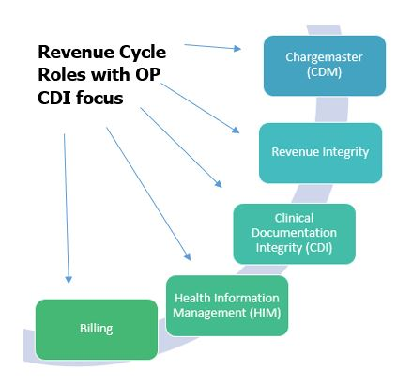
Revenue Integrity at NorthShore University HealthSystem
Structure
Revenue integrity team is composed of analysts and clinicians
  All analysts have coding certificates
  Clinicians have experience working in the ED, ICU, NICU, interventional areas
    Six coders
    Four nurses
  All perform some type of OP CDI function

Slide 30




Outpatient CDI Functions in Revenue Integrity
Revenue integrity serves as an intermediary between various departments with efforts focused on maximizing revenue, acknowledging the need for compliance with laws and regulations, and focusing on ethical business practices
OP CDI goal is to ensure the success of the revenue integrity Ddepartment
Charge Capture
Identify opportunity and reduce redundancy
Ensure appropriate internal charging processes and documentation guidelines are being followed
Denial Reduction
Work with patient financial services to appeal payor denials using federal and commercial policy criteria
Improve front-end processes to decrease the number of back-end denials related to coding, charging, and billing
Education
Educate hospital departments and physicians on best practice coding, documentation, and billing procedures
Compliance
Facilitate medical records collection for federal, regional, and commercial audits
Implement new policies and procedures
Annual review of coding and policy changes
Hold and review all accounts with unfavorable findings
Educate impacted departments to mitigate risk as identified and advised by the compliance department
Peer to peer review of commercial audits
Department outreach with new policies and regulation

Slide 31
CDI Professional Functions
Serve as the bridge between revenue cycle and clinical staff
Understand front and back-end processes
Conduct ancillary and nursing unit chart reviews focused on documentation and charge accuracy
Perform shadowing and coaching with key stakeholders in clinical departments
Provide reporting and feedback to clinical departments based on claim accuracy and chart reviews
Perform reviews of potential missing charges, perform root cause analysis, and educate on solution

Slide 32
Evolution of the Revenue Integrity/OP CDI program at NorthShore
Revenue integrity is a relatively “new” department at NorthShore
  The core of NorthShore revenue integrity was previously known as coding and billing operations (CBO)
    Filled various specialized roles in middle revenue cycle
    Had a compliance aspect but was not compliance
    Worked with operations but in a limited capacity
    Lacked organizational awareness or support
Revenue integrity became the industry standard equivalent for CBO functions
Coding and billing operations was transformed into revenue integrity
  Process
    Identify core functions
    Mission
    Identify lacking parts and roles that were absent
    Partner with other revenue cycle departments

Slide 33


Partnerships for Success
Internal
  CDM is very frequently part of revenue integrity programs
  Other mid-cycle department’s such as HIM and billing work closely in tandem with RI to ensure payment accuracy
  Partnerships with patient financial services, contracting, and front-end operational leadership
External
  Other healthcare organizations
  Vendors
    Do you hire a plumber, or do you DIY the leaky faucet?
  Payers
https://www.google.com/url?sa=i&url=https%3A%2F%2Fqdcutah.com%2Femergency-plumbing%2F&psig=AOvVaw18Pg_eI69BkXmg0244bbjv&ust=1613601947198000&source=images&cd=vfe&ved=0CAIQjRxqFwoTCNDd2eq97-4CFQAAAAAdAAAAABAr
https://www.google.com/url?sa=i&url=https%3A%2F%2Fwww.popularmechanics.com%2Fhome%2Finterior-projects%2Fhow-to%2Fa3095%2F5-steps-to-fix-a-leaky-faucet-15470175%2F&psig=AOvVaw2udmIBIR6JMUSldasMyDvp&ust=1613602116125000&source=images&cd=vfe&ved=0CAIQjRxqFwoTCJDa57rA7-4CFQAAAAAdAAAAABAD

Slide 34
Addition of OP CDI to Revenue Integrity
The success seen from partnering with Claro Healthcare for inpatient CDI side resulted in performing an outpatient facility CDI assessment
Forming OP CDI in revenue integrity
  New team members
  Comprehensive training focusing on OP CDI
    RI, CDM, HIM, clinical staff
Creating an OP CDI workplan
  Driven by data monitoring, process tracking, root cause analysis, quality assurance, solution implementation, etc.

Slide 35




Outpatient Clinical Documentation Specialists
Who is best suited for a role in OP CDI?
  Coders (specialty trained a plus)
  Nurses with operations knowledge
  Analysts with knowledge of finance, CDM, reimbursement structure, government regulatory and compliance requirements
  NorthShore team consists of RHIA, RHIT, CIRCC, CCS, RNs with ED, ICU, IR, NICU experience

Slide 36
OP CDI Initiative Spotlight
Emergency Department E/M Level Project – Partnered with Claro Healthcare

Slide 37
Emergency Department E/M Level Project
Project highlights
Multidisciplinary Collaboration
Considerations
Goal:
Accurately reflect patient severity and level of care administered in the ED
Level Approach
CDS Role

Slide 38

Multidisciplinary Collaboration
OP CDI Staff
  Revenue integrity-led project
ED Clinical Leadership
  Shared clinical experience
  Patient population
  Guidance on documentation
  Insight on workflows and impact
Compliance
  Ensure regulatory guidelines were adhered to
  Separately reportable items
Information Systems
  Project scope
  FCC module in ASAP
  Internal workplan
  Timeline
Claro Healthcare
  Project workplans
  Criteria development and inclusion
  Data analysis and modeling
  Workflow optimization
  Clinical and coding expertise, chart reviews
  Education and roll out to clinical staff
  Project dashboard, monitoring, and measurement

Slide 39

Level Approach
Criteria
  NorthShore specific criteria based on services provided
Manual approach
  Utilize staff to review record and apply ED level
Semi-automated
  System and staff work in tandem to apply an ED level
Automated
  Leverage system to apply ED level

Slide 40

Considerations
Desired outcomes
  Efficient workflow
  Ability to easily update as needed
Criteria
  Reflective of resource utilization
  Better reflect patient severity
  Provide an organizational uniform standard
Revenue opportunity
  Significant
Timeline
  Approach
  Resources
  Rollout

Slide 41

Clinical Documentation Specialist Role
Educate
  Assist clinical staff on new documentation fields
  Provide an understanding of new processes
Monitor
  Audit ED charges
  Verify criteria is applied appropriately
Identify
  Level discrepancies
  Documentation improvement opportunities
  Potential criteria adjustments

Slide 42
Outpatient Clinical Documentation Integrity
Questions?

Slide 43
Closing Remarks
Thank you for attending today’s meeting!

