Slide 1
NAHRI Pacific Northwest Chapter – Alaska, Oregon, and Washington
Inaugural Meeting
December 4, 2020

Slide 2
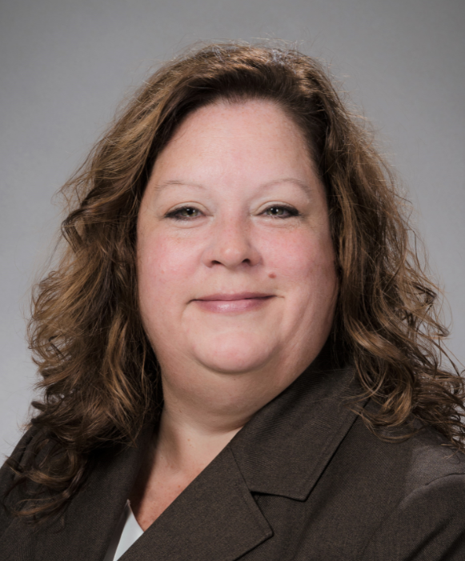
Regional PNW Chapter Leader, Jennifer Fortin, CPC-H
Senior Director, Revenue Integrity, UW Medicine Health System
Jennifer is a proven healthcare industry leader with demonstrated expertise in all areas of revenue cycle, helping multiple healthcare systems and academic medical institutions develop robust, system level Revenue Integrity programs. Most recently Jennifer joined UW Medicine (April 2020), an academic health system represented by three separate facility campuses and multiple Ambulatory settings in and around Seattle. In this role she provides leadership for extensive audit structures, enhancing Service Line revenue realization and system-wide charge reconciliation and ensures the financial health of the organization. Jennifer has served in variety of leadership roles across the country, including Augusta University in GA, Mission Health System in NC and Memorial Health System in OH, in positions accountable for strategic pricing, financial reimbursement profiles for service lines, systems management and data integrity and reporting. Jennifer also brings significant experience in facility and professional reimbursement methodologies, charge master management, pricing transparency, denials management, and charge integrity.

Slide 3

Regional PNW Chapter Leader, Conan Cope
System Director, Revenue Cycle Operations, PeaceHealth
Conan brings over 15 years of passion, commitment, and revenue cycle experience to NAHRI. His leadership experience within revenue cycle includes coding, patient registration, release of information and patient financial services. Prior to supporting the Pacific Northwest, Conan supported organizations in many states across the country including California, Colorado, Georgia, Hawaii, Maryland and Virginia. Conan is currently the System Director of Revenue Cycle Operations for PeaceHealth. Conan has been instrumental in system implementations, process improvement initiatives, and sharing best practices in large healthcare systems. Conan is proud of his HBCU, Hampton University and received his graduate education from Colorado State University. Conan is both Lean and Agile Scrum certified along with several Epic certifications including Resolute, Prelude, Cadence, and Welcome.

Slide 4

Regional PNW Chapter Leader, Jessica Raven
Senior Systems Analyst, UW Physicians
Jessica has over 20 years of revenue cycle experience, with a focus on implementation and optimization of academic medical system processes through systems integration. Currently, she is a Senior Systems Analyst with UW Physicians, the practice group for over 2,000 providers and other healthcare professionals who care for patients at UW School of Medicine, Seattle Cancer Care Alliance and UW Medicine facilities in the Seattle, Washington area. Her responsibilities include Charge Master analysis, updates and support. Jessica holds Epic certifications in Prelude, Resolute Professional Billing Administration, Resolute Professional Billing including Single Billing Office, Resolute Professional Billing Claims Administration, Benefits Engine Basics, Benefits Engine Healthplan and Charge Router. Jessica’s brings with her experience on both the payor and provider side of the house, through which she has gained a comprehensive understanding of the Revenue Cycle in its entirety.

Slide 5
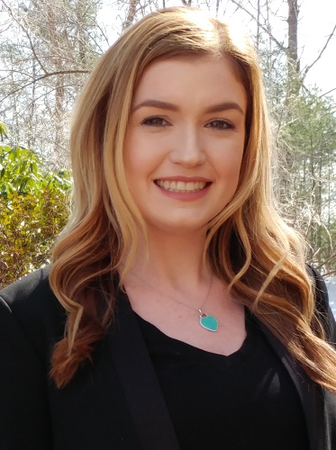

NAHRI Leadership
Jaclyn Fitzgerald, Director of NAHRI
jfitzgerald@hcpro.com
Kevin Duffy, Associate Content Specialist
kduffy@hcpro.com

Slide 6

Alaska Hospital Statistics*
Alaska:
Hospitals: 10
Staffed beds: 1,235
Patient revenue: $5.37B
References:
*American Hospital Directory: https://www.ahd.com/states

Slide 7

Oregon Hospital Statistics*
Oregon:
Hospitals: 37
Staffed beds: 6,139
Patient revenue: $28.62B
References:
*American Hospital Directory: https://www.ahd.com/states

Slide 8

Washington Hospital Statistics*
Washington:
Hospitals: 62
Staffed beds: 10,322
Patient revenue: $66.39B
References:
*American Hospital Directory: https://www.ahd.com/states

Slide 9
Total Hospital Statistics*
All Three States:
Hospitals: 109
Staffed beds: 17,696
Patient revenue: $100.42B

Slide 10
Member Introductions
Pacific Northwest Regional Chapter Members

Slide 11

Pacific Northwest Regional Chapter Members
Beth Stout – WhidbeyHealth
Cheryl Mustard-Adams – UW Medicine
Samuel Nau – North Valley Hospital
Jennifer Foskett – Overlake Hospital

Slide 12
NAHRI Regional/Local Chapters
www.nahri.org/local-chapters
forums.nahri.org

Slide 13
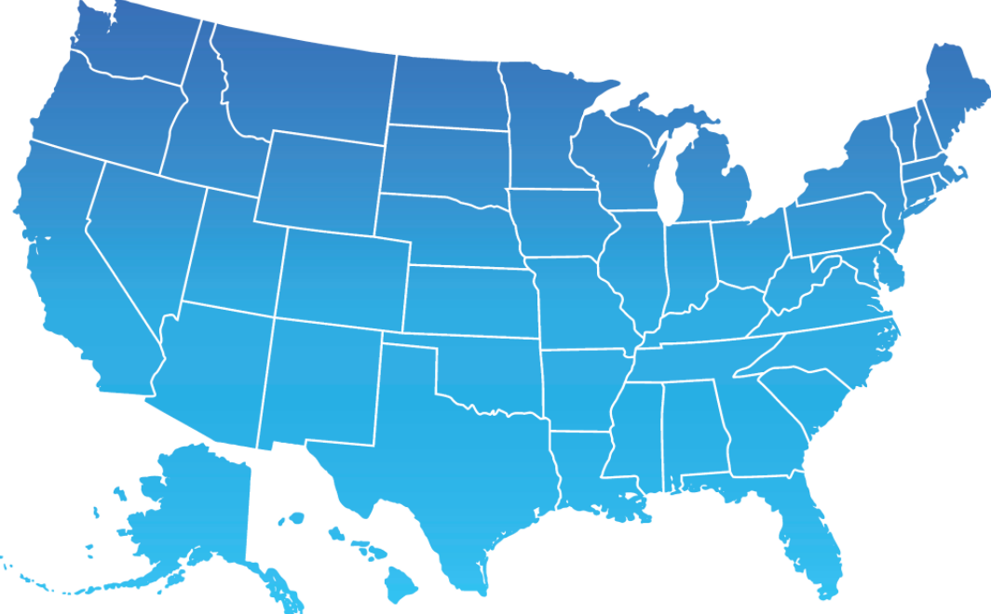
NAHRI Chapters Across the Country
Pacific Northwest Regional Chapter
  Alaska, Oregon, Washington
Texas Local Chapter
Northern Plains Regional Chapter
  South Dakota, North Dakota, Montana, Wyoming, Nebraska
MN-WI Regional Chapter
Illinois Local Chapter
Big 10 Regional Chapter
  Michigan, Ohio, Indiana, Iowa
GA-FL-AL Regional Chapter
NC-SC Chapter
New England Regional Chapter
  New Hampshire, Maine, Massachusetts, Rhode Island
Mid-Atlantic Regional Chapter
  DC, Delaware, Maryland, New Jersey, New York, Pennsylvania, Virginia

Slide 14
Price Transparency Strategies for 2021

Slide 15

Guest Speaker – Greg Kay
Greg has managed and consulted in healthcare for 32 years. During that time, Greg has worked with leading healthcare provider organizations with data analytics for improved revenue cycle performance, managed care negotiation, strategic pricing, consumer engagement and product development/implementation. Greg is a University of South Carolina finance and marketing graduate and was recognized in 2012 as a Business Leader Top 50 Entrepreneur. Greg is a strong believer in the transformational nature of data-driven decision making and has presented to numerous HFMA chapter on the subject of pricing transparency.

Slide 16
Winning Price Transparency Strategies for 2021
This session is designed to help ensure you are ready to meet the CMS price transparency mandate and understand the key considerations for next year. By attending, you will learn:
Options and solutions for meeting the CMS price transparency mandate
Visual examples of the final files to publish on your hospital's website
How to use published charge data as a competitive advantage in 2021

Slide 17


Good Morning!
Greg Kay VP, Revenue Strategy
Greg.Kay@pmmconline.com
PMMC provides high-value revenue cycle software and services to improve the financial performance of healthcare providers. Our software and expertise focuses on payment accuracy and identifying more revenue opportunities across the revenue cycle. PMMC helps hospitals with contract governance, payer negotiations, price transparency and value-based reimbursement. Clients see, on average, a 10 to 1 return on investment with software and services.
For more information, visit www.pmmconline.com

Slide 18

Price Transparency Mandate & Patient Estimates
Pricing Transparancy Compliance
  Standard Charge File
  Shoppable Services (file or self-service estimation tool)
Increased Patient Engagement
Improved Payer Contractual Negotiations

Slide 19
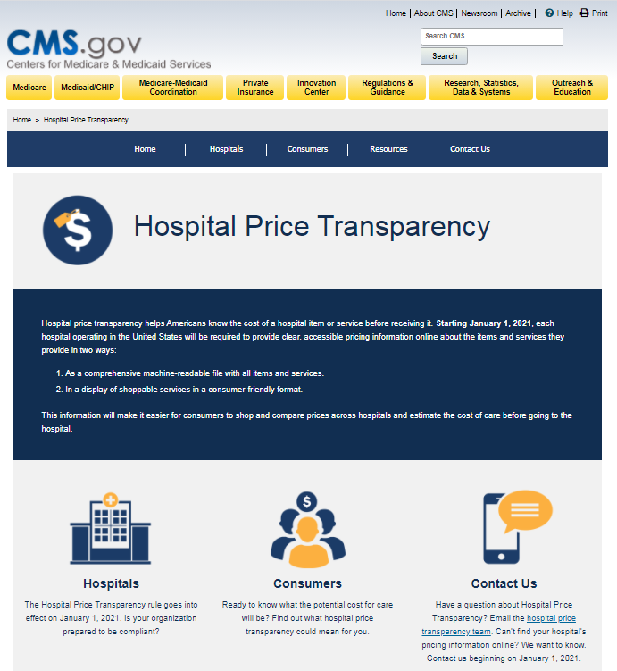
CMS Price Transparency
What is the effective date of the final rule?
Effective January 01, 2021
Where can I find the final rule?
Final rule is CMS-1717-F2
What support documentation is available?
https://www.cms.gov/hospital-price-transparency
Medicare Learning Network (MLN Event) Session
Hospital Price Transparency Webcast
December 8, 2020 2:00 – 3:00 pm EST

Slide 20
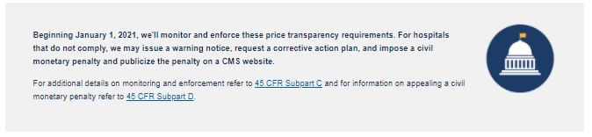
CMS Price Transparency
Enforcement

Slide 21

CMS Price Transparency
What Standard Charges must now be published?
Comprehensive Machine Readable File
A comprehensive single machine-readable file that makes public all standard charge information for all items and services provided by the hospital
Five Defined Components
Gross charges
Payor-specific negotiated charges
Discount cash prices
De-identified minimum negotiated charge
De-identified maximum negotiated charge
Consumer-Friendly Shoppable Services
A consumer-friendly list of standard charges for 300 shoppable services (70 defined by CMS & 230 hospital-selected)
Additional Considerations
The shoppable services should be grouped/calculated based on the primary procedure / service and incorporate other related ancillary services (i.e. Room & Board, Lab, Rad, Rx, Employed Professional Charges customarily provided by the hospital)
Hospitals can meet the shoppable service requirement by deploying an internet-based price estimator tool

Slide 22
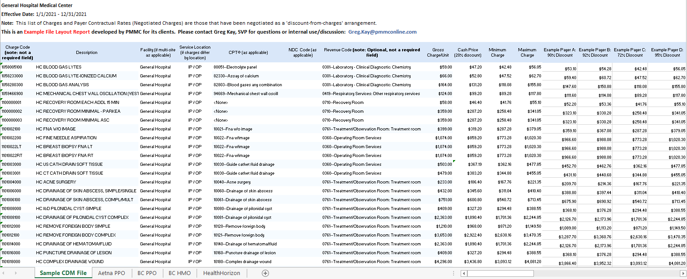
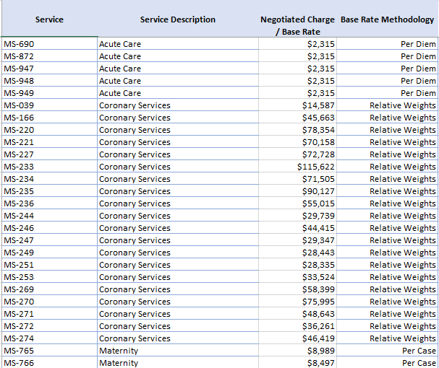
CMS Price Transparency
Example Standard Charge (Machine-Readable) File
Example Negotiated Charge File & Service Packages

Slide 23
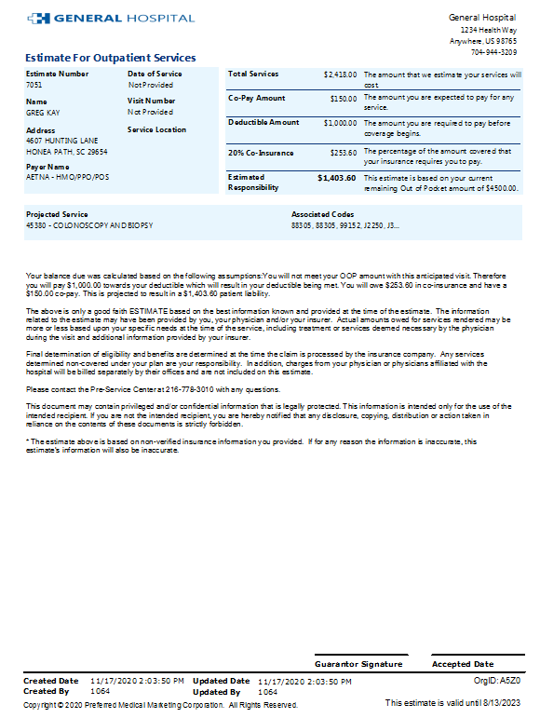
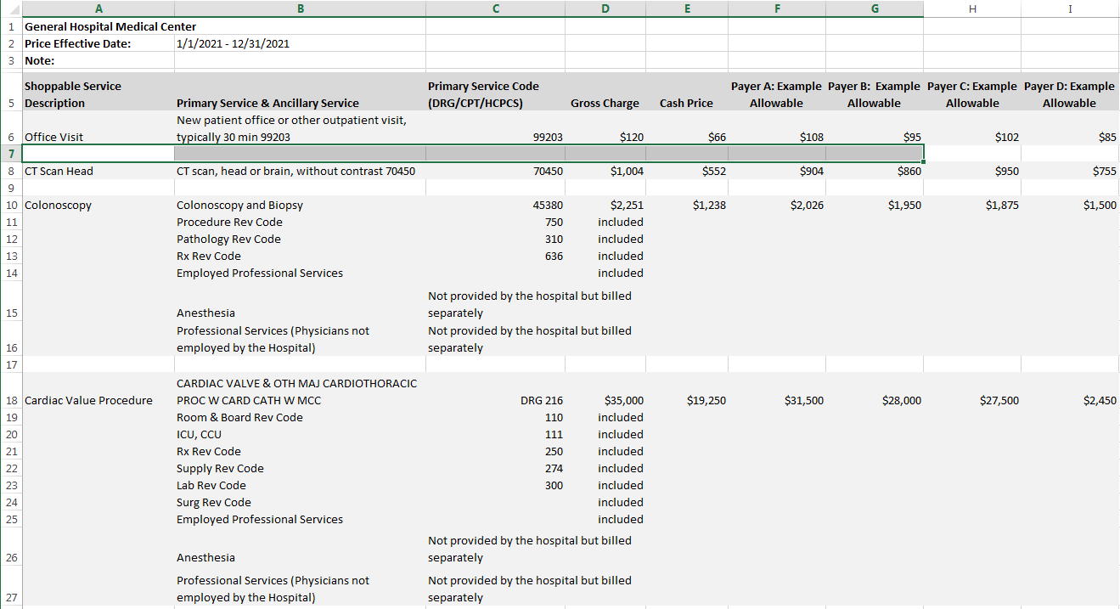
CMS Price Transparency
Shoppable Service Deliverable
Option 1: Sample File
Option 2: Self-Service Estimate Tool

Slide 24
Price Transparency Mandate
Post January 01, 2021
Pricing Transparancy Compliance
  Standard Charge File
  Shoppable Services (file or self-service estimation tool)
Increased Patient Engagement
Improved Payer Contractual Negotiations

Slide 25
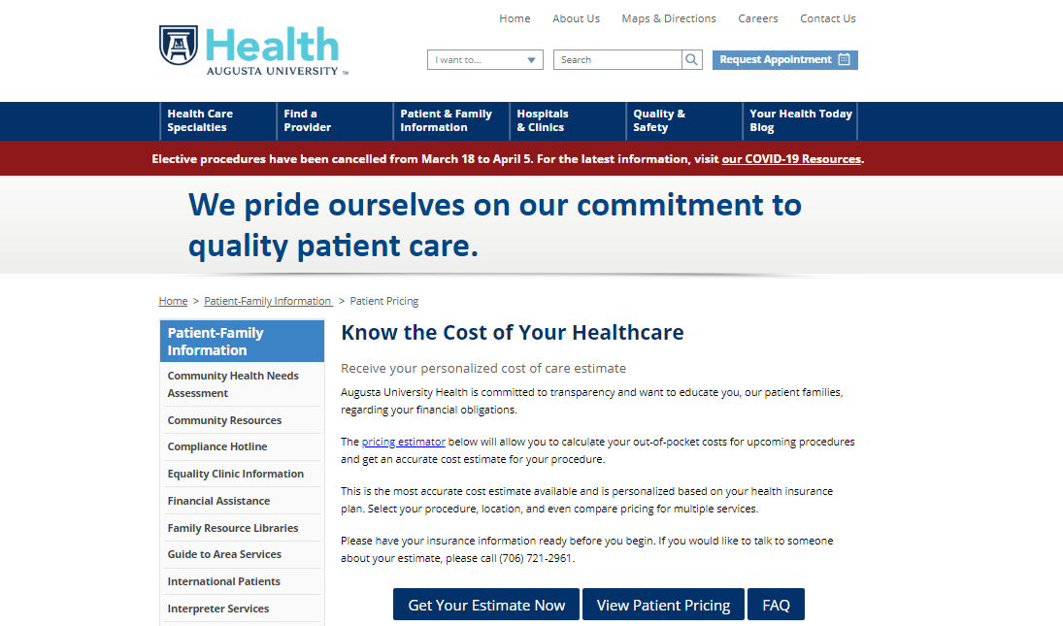
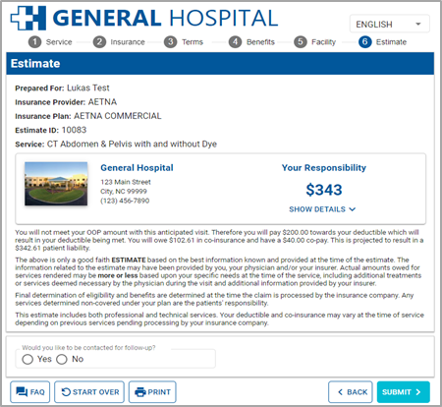

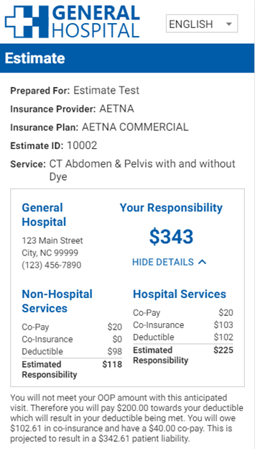
CMS Price Transparency
Online Shoppable Services Can Lead to a New Level of Client Engagement

Slide 26
Patient Centric Financial Experience
Putting the Pieces Together
Provide
Charge
Provide
The retail price of all charges that roll up to a particular service (the hospital’s CDM price)
The discount price is a lower rate that payers / patients negotiate (the ‘contractual rate’ / ‘allowable’ / self-pay discount).
Price
Cost
Improve
Engage
Patient’s financial responsibility (their cost for the service based on benefit coverage and the discounted price).
Excel
Seamless and integrated options to provide ‘peace of mind’ and loyalty.

Slide 27

Digital Consumer Engagement
Meeting Habitually Connected Consumer Expectations

Slide 28
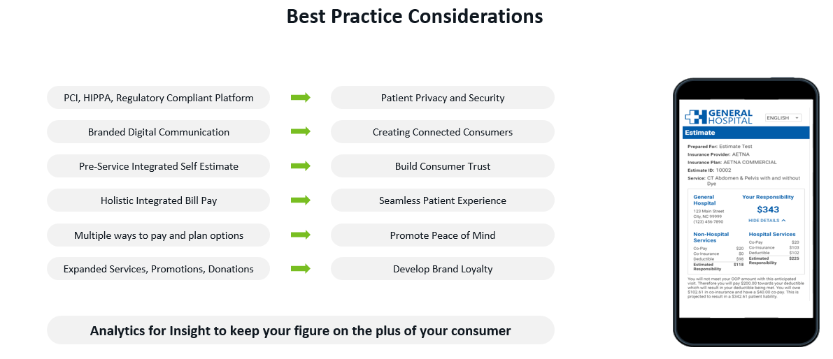
Digital Consumer Engagement

Slide 29
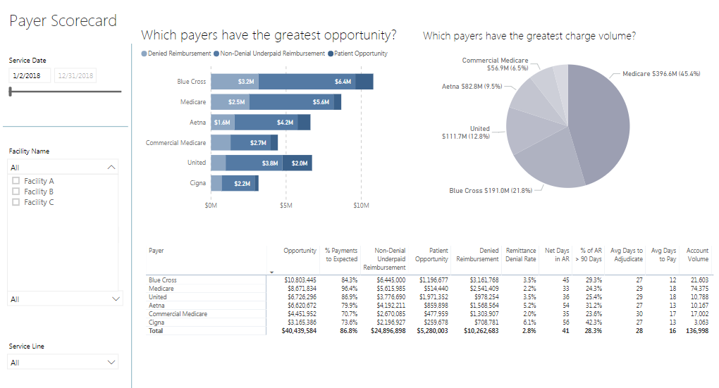
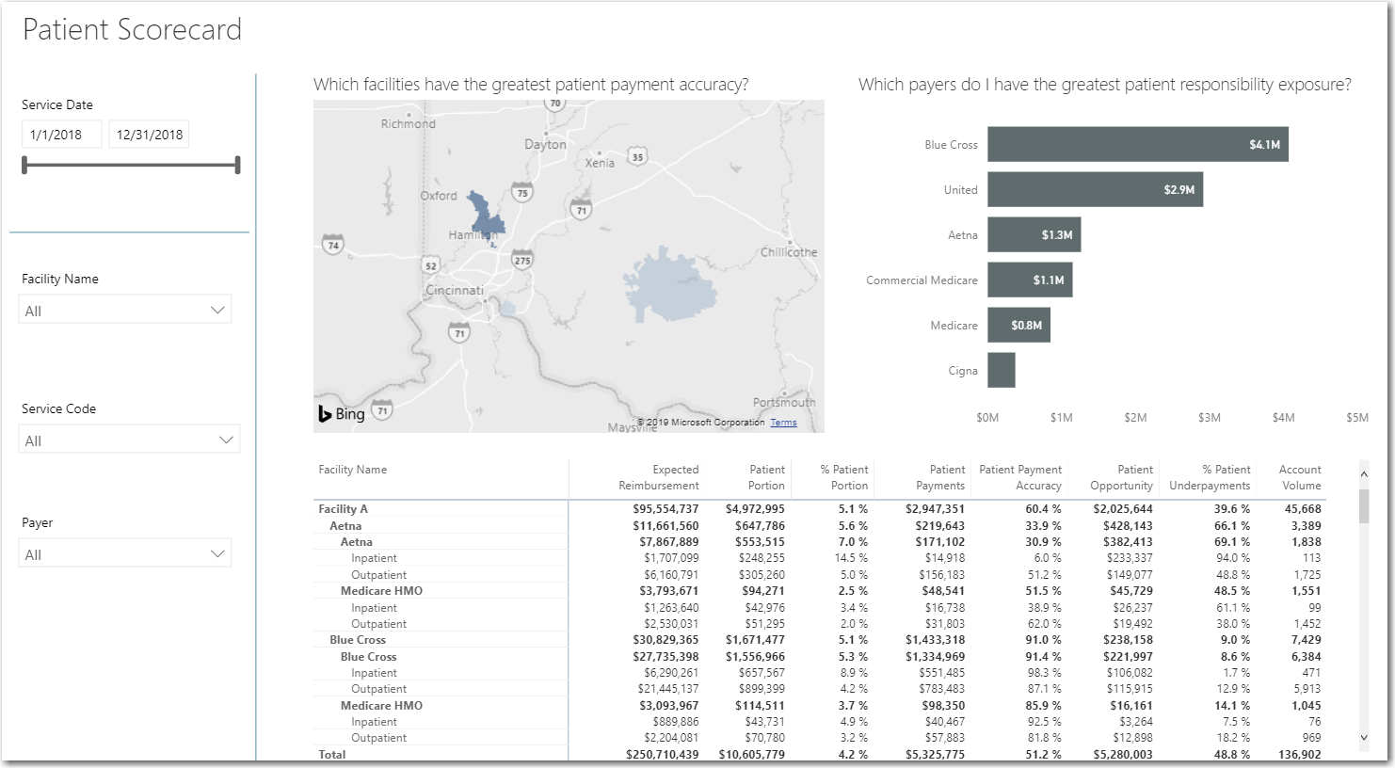
CMS Price Transparency
New Analytic Considerations

Slide 30
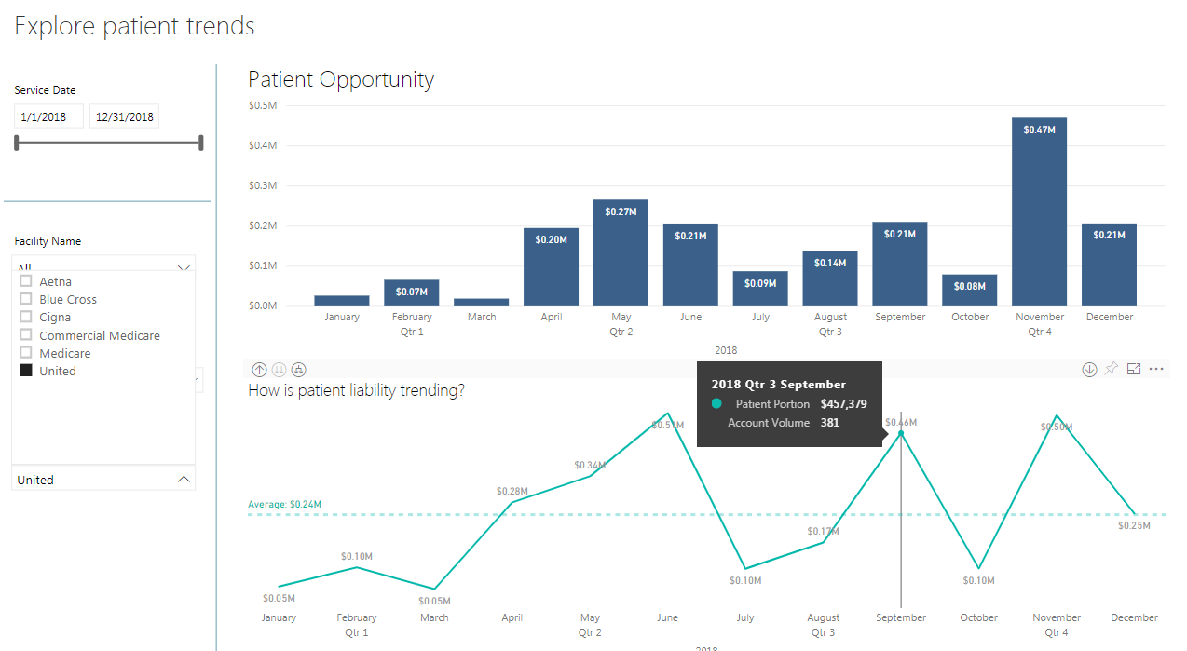
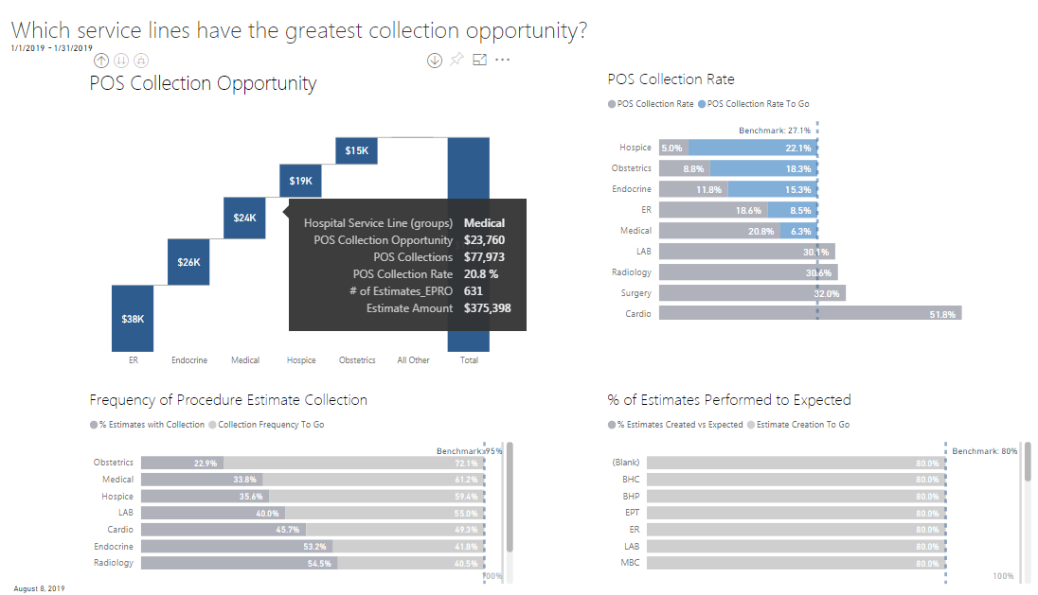
CMS Price Transparency
New Analytic Considerations

Slide 31
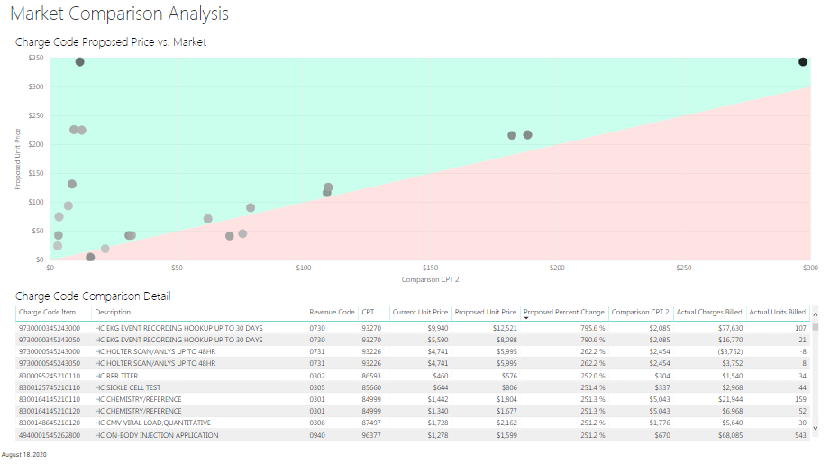
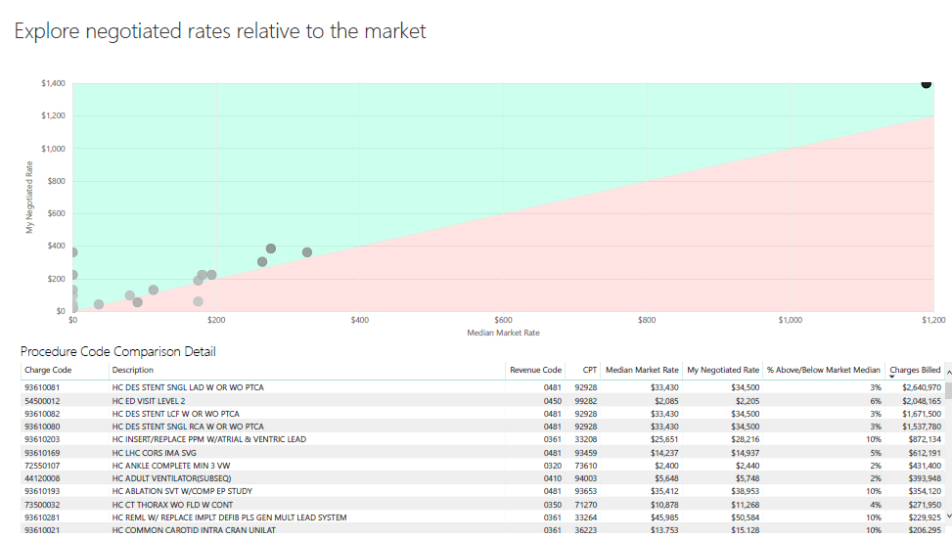
CMS Price Transparency
New Analytic Considerations

Slide 32
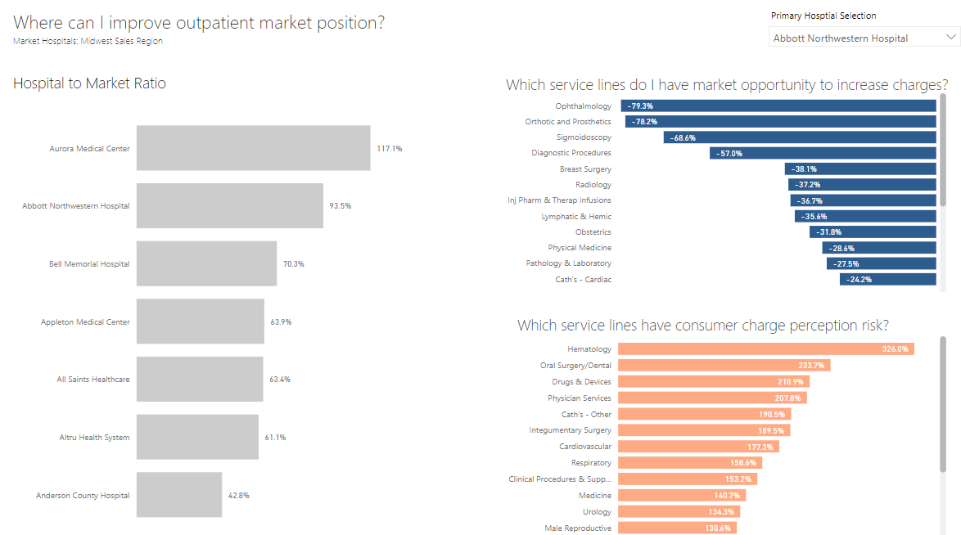
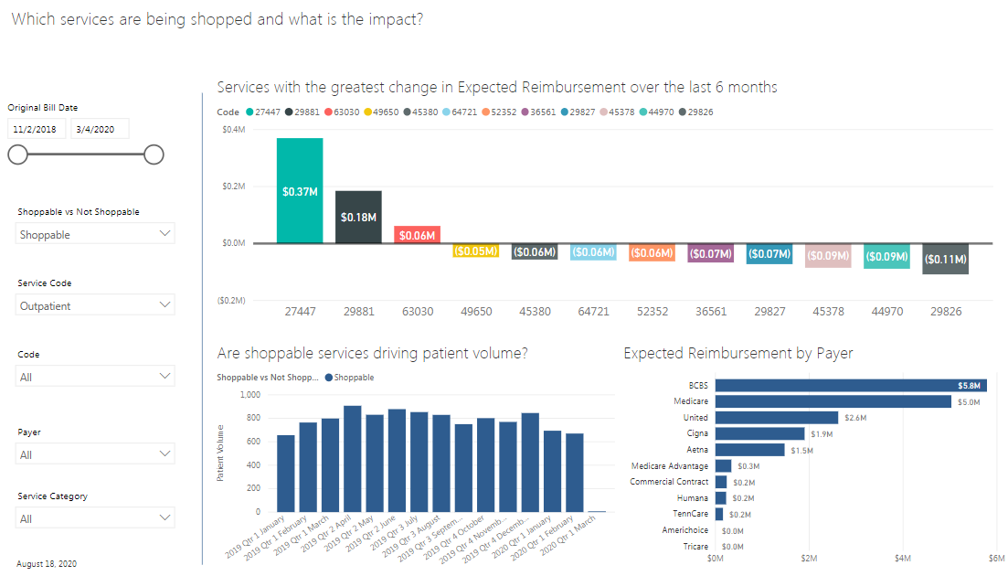
CMS Price Transparency
New Analytic Considerations

Slide 33

2021 Strategy for:
Charge, Price, Cost & Engagement
Real Pricing Transparency Is Coming
Where are our areas for improved online consumer engagement?
How do I connect the coming healthcare shopping experience with my payer contracting process?
Does my current payer contract strategy really reflect the shift that is occurring with consumerism?
How do I improve our internal communication process and analytical platforms for an integrated retail and discount pricing strategy?
Do we have the right team and tools to score-carding performance and leverage new data to improve our negotiation positions?

Slide 34
Thank You!
Greg Kay VP, Revenue Strategy
Greg.Kay@pmmconline.com
PMMC provides high-value revenue cycle software and services to improve the financial performance of healthcare providers. Our software and expertise focuses on payment accuracy and identifying more revenue opportunities across the revenue cycle. PMMC helps hospitals with contract governance, payer negotiations, price transparency and value-based reimbursement. Clients see, on average, a 10 to 1 return on investment with software and services.
For more information, visit www.pmmconline.com

Slide 35
Charge Master Management
nThrive presentation to PNW NAHRI

Slide 36
Presenter Bios
Charge Master Basics
Overview – CDM Maintenance
CDM Best Practices
Operational Integration
Q&A
Agenda

Slide 37
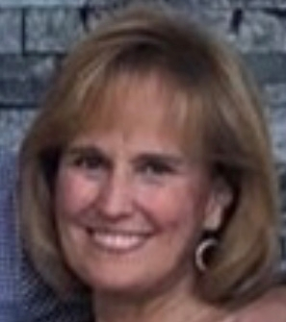
Today’s Presenter
  Sherry Nardi
Sherry has over 25 years of healthcare experience in revenue cycle operating, sales and supply chain roles.
She provides charge integrity solution strategy expertise to providers in partnership with nThrive Sales and Client Management, with a focus on consulting and web-based solutions. Sherry works closely with Product Management to ensure charge integrity solutions are continually meeting the needs of our clients and are addressing healthcare industry changes.
She has also previously led implementations for these solutions. Prior to joining nThrive in 2000, Sherry was in charge of Supply Chain Purchasing/Contracting at Children’s Healthcare of Atlanta.

Slide 38
Charge Master Basics

Slide 39
Charge Master Overview
A hospital’s charge description master…
(Often shortened to just CDM) is a database of all items, services, and supplies used in patient care with the associated prices.
A typical charge master line item includes
the following:
Department number
Procedure number (charge item number)
Procedure description
HCPCS (CPT, Level II, or Level III) codes
Revenue code
Price
The procedure item number is what is posted to the patient’s account and detailed on the itemized bill.
The procedure item charge descriptions on the charge master are what appear on the claim form.
The revenue generated from each line item flows into the hospital’s accounting system for cost and utilization purposes.

Slide 40
Key Chargemaster Challenges Faced By Health Systems
Limited staff –
problem keeping up with
1,000s of line-item updates
Compliance issues –
create payor denials and risk
Pricing transparency –
Difficulty estimating patient responsibility & providing
defensible pricing
Chargemaster System Coverage
Labor-Intensive Process
Notes:
If you lack a comprehensive and compliant CDM, your organization is bleeding revenue. Your financial wound is very large if you capture only outpatient and hard coded lines of data that typically represent just 30% of your opportunity and this pricing data is more than six months old. And your wound is often plagued with hundreds to thousands of item master issues that your staff don’t have the time to resolve. As a consequence, an infection is growing through non-compliant, lost inpatient, observation and other soft coded charges that drain both your revenue and resources.

Slide 41
Overview // CDM Maintenance

Slide 42
Where Does CDM Maintenance Begin?
CDM maintenance is an ongoing process to ensure services are accurately charged, that the hospital is compliant with Medicare regulations, and receives appropriate reimbursement.
  Team members should have a thorough understanding of coverage, payment
  and reporting issues.
  Ancillary staff should participate to ensure that codes and charges reflect services/procedures actually performed.
  Establish a Charge Master Team comprised of members from:
CDM Coordinator
Finance/Billing Personnel
Compliance Officer/Legal/Risk Manager
Ancillary Directors
Nursing Administration
Information Systems
HIM

Slide 43
Why is Ongoing Maintenance Necessary?
Ongoing CDM maintenance is necessary for:
New Procedures/Services
New supplies
Charge Revisions
Charge Deletions
Changes in hospital departments
CMS updates
CDM maintenance provides accurate and complete data for:
Correct coding and charging
Ensures appropriate reimbursement for each procedure code
Enhances hospital’s ability to report correct statistics to governmental agencies
A well designed and maintained CDM can also improve staff (coding, charging, and billing)
productivity, reduce claim and line-item denials, while minimizing recoupment and audit risk

Slide 44
CDM Best Practices

Slide 45

How Do We Begin Working Toward
Best Practice?
Establish a written protocol:
  The process for submitting revisions, additions, and deletions/deactivations
  The sequence for obtaining CDM change approvals
  Turn-around time for changes to be implemented
  Firmly establish controls on who has authority and
  system access to update the CDM
Establish process(es) to ensure order entry system
or manual charge tickets accurately reflect services provided and that all services in order entry or on charge tickets are reflected in the CDM.
Establish guidelines for the frequency of CDM updates.

Slide 46

How Often Should We Review, and in What Ways?
The charge master should be reviewed at minimum quarterly when the CMS updates occur.
Each ancillary department should be responsible for conducting a brief monthly review of their department’s CDM.
The CDM should be updated as often as necessary for:
  CMS/Fiscal Intermediary updates
  New procedures or services
  New supplies
  Pricing changes
Verify accuracy of CPT/HCPCS and revenue codes.
Compare descriptions from CPT codes to the CDM description.

Slide 47

What Should We Monitor Within our CDM?
Review charge amounts against reimbursement amounts.
Compare order entry/charge tickets with the CDM.
Provide clarification of descriptions/charges/ codes and discuss the following with the departmental staff:
  Line items with unlisted codes
  Procedures performed in the unit/department,
  and what supplies are included
  Non-reportable charges
Monitor claims or perform chart reviews for compliance, reimbursement, code acceptance.
Identify and routinely validate the need for any:
  Duplicate charges across the enterprise
  Duplicate charges within a department
  Zero-volume charges
  Zero-dollar charges

Slide 48
Operational Integration

Slide 49
Build a Strong, Integrated Structure
CDM Management can “live” in different areas based
on your organization:
Compliance
HIM (under coding or charging)
Coding (broken out separately from HIM)
Patient Accounts/Patient Financial Services
When several different structures are acceptable,
evaluate based on:
Technology and system infrastructure
  Patient Accounting platform
  Surgical Systems platform
  Radiology Systems platform
Reimbursement Considerations
  Managed Care Contracts
Local practices

Slide 50
How can Departmental (Operational) Managers
Help the Charging Process?
Correct coding problems at the source.
Rejections due to CPT/HCPCS errors should be directed to the appropriate ancillary department or to the HIM department to ensure codes reflect services/procedures performed
Ask the business office to communicate departmental issues regarding repetitive claim denials
“Own your charges”:
Remain current on all CMS guidelines, FI provider bulletins, and local coverage policies
Ensure all codes assigned by HIM or hard-coded in the CDM are transferring properly to
the claim
Regularly update the charge master with any coding or billing changes
Ensure accurate and complete documentation in the medical record and use qualified personnel to assign the appropriate codes.

Slide 52
Sherry Nardi snardi@nthrive.com

Slide 53
Closing Remarks
Thank you for attending today’s meeting!

