Slide 1
Utilization Management 360
Breaking Down the Silos
®
A WEBINAR PRESENTED ON NOVEMBER 19, 2020

Slide 2
National Association of Healthcare Revenue Integrity (NAHRI)
NAHRI’s mission is to enhance the revenue integrity profession through standards, advocacy, networking, and the promotion of shared knowledge and resources.
NAHRI Benefits
  As a NAHRI member, you’ll get unlimited access to our vast members-only resources, tools, and content such as white papers, best practices, and research reports written by the most respected names in the industry.
  Resources include:
    Member-Only Content, explore the hundreds of the latest articles and research by topic, including white papers and best practices, plus an extensive archive on the NAHRI website
    A library of sample webinars and other content on the latest revenue cycle topics
    NAHRI quarterly journal, featuring in-depth, members-only content on the latest developments in revenue cycle

Slide 3


NAHRI Local Chapters
NAHRI endorses the formation of regional, state, local, and subject-specific networking organizations. NAHRI encourages the collaboration of such groups with the national body and supports the alliance of the local and national groups for mutually favorable principles. Each chapter must choose three officers who must be from different healthcare organizations and who are current NAHRI national members to act as liaisons between the parties.
Interested? Visit nahri.org/local-chapters or email NAHRI Associate Editor Kevin Duffy at kduffy@hcpro.com

Slide 4



Utilization Management 360
®
Breaking Down the Silos
John Zelem, MD, FACS, Owner Streamline Solutions Consulting, Inc.
Glenn Krauss, CEO & Founder Core-CDI, Co-Founder Top Gun Audit School
Copyright 2020 – All Rights Reserved

Slide 5
Agenda
Concept Overview
  The Holistic Approach
  Sports Team Analogy
The solution?
What is the PROCESS
Steps toward the solution
Conclusions
Copyright 2020 – All Rights Reserved

Slide 6

Taking The Holistic Approach
Think about the Big Picture
One part affects the whole
Yet, No Part is more
Important
Than the Whole
Copyright 2020 – All Rights Reserved

Slide 7
Concept Overview
Utilization Management 360
™
Utilization
Review
Case/Care Management
Clinical Documentation Integrity
Onsite Physician Advisor
Coding
Compliance
Revenue Cycle
Copyright 2020 – All Rights Reserved

Slide 8
Revenue Cycle
Hospitals and Health Systems must continually update their current revenue cycle processes, becoming more efficient in the area of indirect costs, eliminate inefficient processes to drive revenue preservation that translates into optimal net patient revenue.
Copyright 2020 – All Rights Reserved

Slide 9
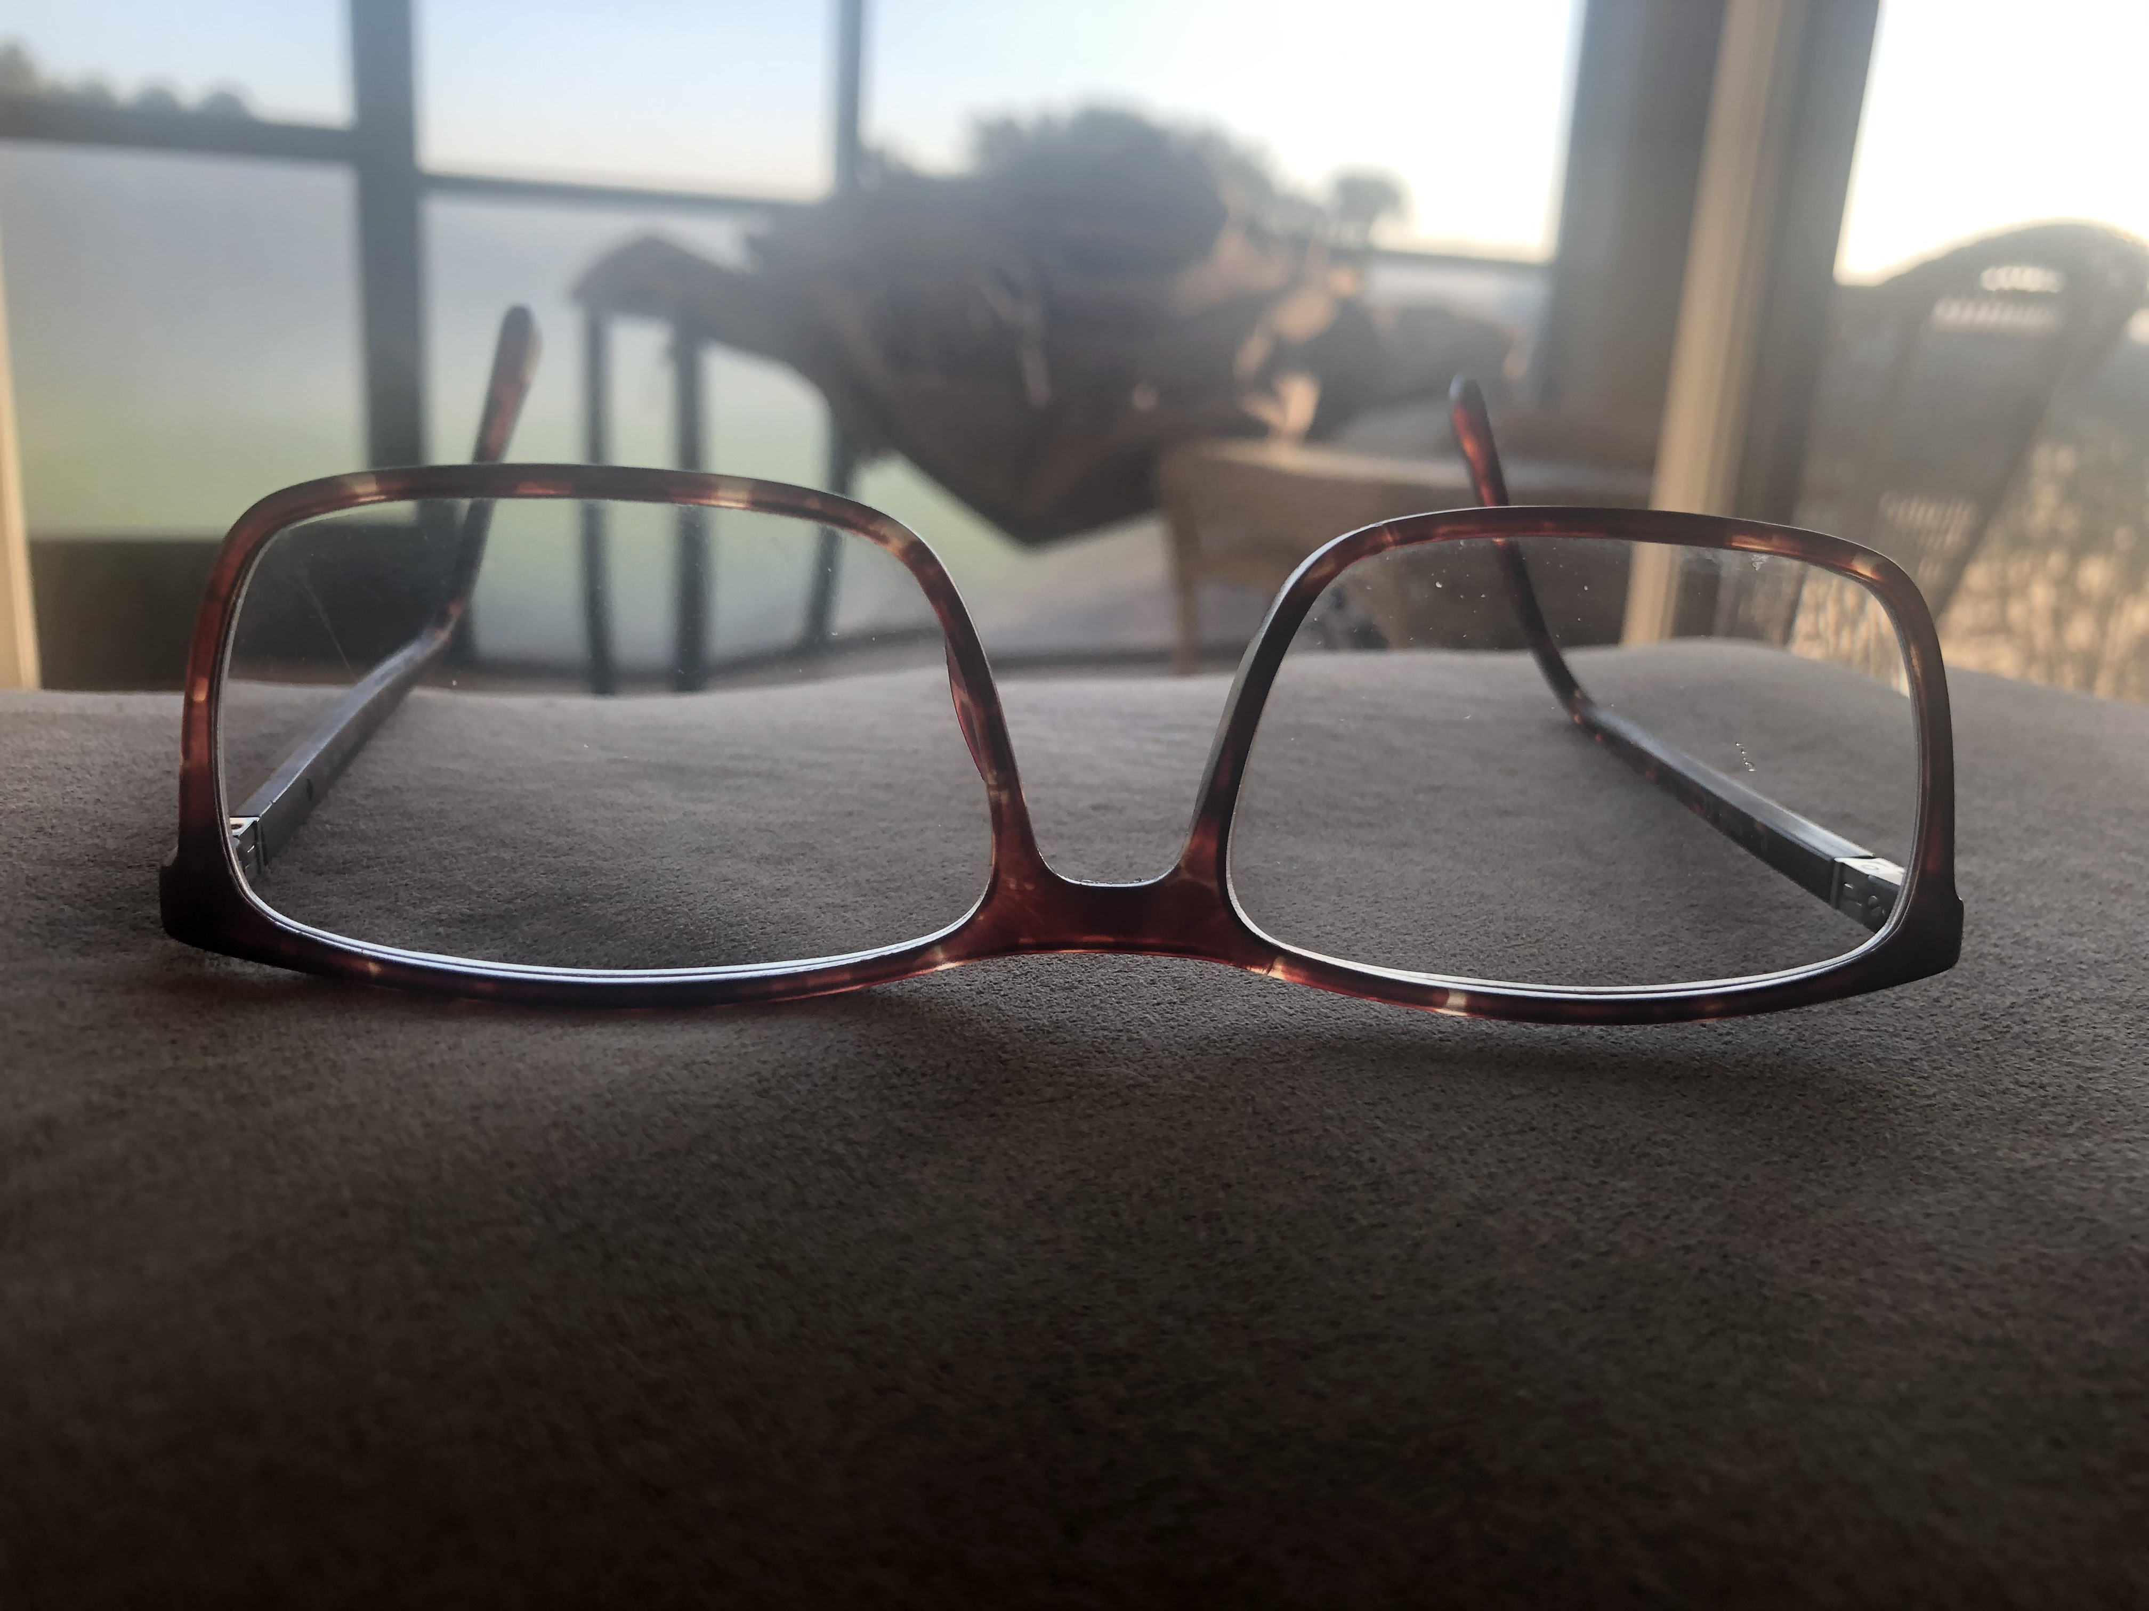
Challenges
These components typically exist in silos today
  YET…
All involved are looking at the same chart, the same documentation!!!
  But with different lenses - theirs
Copyright 2020 – All Rights Reserved

Slide 10
Keep in Mind!
“Let’s not be territorial, instead let’s be collaborative. Let’s make decisions for the greater good instead of our own advancement. The edification of the process or the company should be the goal, not the expansion of our land ownership”.
https://tabithahapeman.com/territorial-leadership/
Copyright 2020 – All Rights Reserved

Slide 11
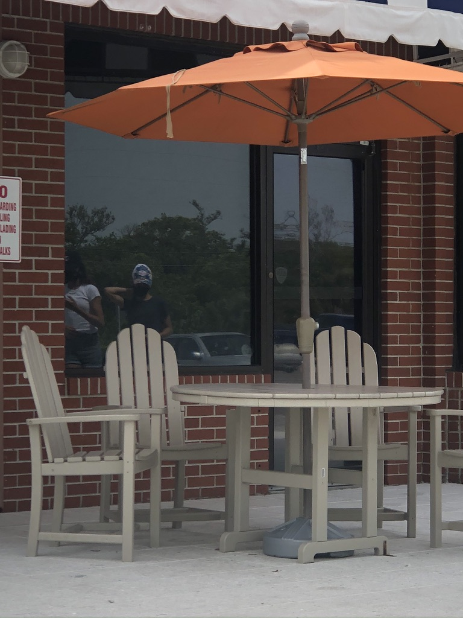
The Bad News is the GOOD News:
The Linking Factor is that Documentation
All are at the same table!
  Validates level of care
  Supports billing and reimbursement for services provided
  Defends against audit
  Reinforces acuity, clarifies the clinical picture
  Influences quality scores: impact on SOI & ROM
  Cross-pollinating knowledge and acumen
Copyright 2020 – All Rights Reserved

Slide 12
Physicians are obliged to document in order to support the care that is ordered and the financial charges for same. "Good clinical documentation is part of the core responsibility of every doctor.”**
In “The Business of Healthcare” blog, 8/31/16, it is stated that “Clear and concise medical record documentation is critical to providing patients with quality care, ensuring accurate and timely payment for the services furnished, mitigating malpractice risks, and helping healthcare providers evaluate and plan the patient’s treatment and maintain the continuum of care.” **
** https://www.scp-health.com/providers/blog/think-with-your-ink-4-reasons-why-proper-medical-record-documentation-is-vital
Copyright 2020 – All Rights Reserved

Slide 13
Hospitals Deserve to get Paid, PERIOD
Documentation reflects direct cost and supports indirect costs
Can continued insufficient documentation that affects revenue continue to be tolerated?
Would any other company allow someone to cost them revenue without consequences?
Many time executives bends over backwards to allow physicians to not do what they should be doing
  Enables poor behavior and affects revenue flow
Copyright 2020 – All Rights Reserved

Slide 14
CDI Cannot and Should Not Do It Alone! Holism
CDI is an important part of indirect cost, used properly can enhance revenue streams
Clinical documentation is at the core of every patient encounter
Documentation must be accurate, timely, and reflect the scope of services provided.
Facilitate the accurate representation of a patient’s clinical status that translates into coded data.
Coded data is then translated into quality reporting, physician report cards, reimbursement, public health data, and disease tracking and trending.
Vital to a healthy revenue cycle, and more important, to a healthy patient.
CDI can materially have a direct impact on patient care by providing information to all members of the care team
Copyright 2020 – All Rights Reserved

Slide 15
Is the Physician Advisor Really a Silo?
"Although silos will continue to exist between the HIM, coding, utilization reviews, and clinical divisions, the physician champion can hover between these divisions and encourage the collaboration and exchange of best practices for documentation so that the patients, the physicians, and the facility can reap the benefits.”
  January 2015, “Navigate the CDI Divide” by Elizabeth S Roop, For the Record, Vol 27 No 1 P 22
Copyright 2020 – All Rights Reserved

Slide 16
Utilize the Physician Advisor to Help with Buy-In for the Other Components
Onsite Physician Advisor
Utilization
Review
Case/Care Management
Clinical Documentation Integrity
Copyright 2020 – All Rights Reserved

Slide 17
1 - UR Evaluates
Patient
2 - Case Management
Care Progression
5 - Coding Review Submit Claim
Meet IP
Criteria
Yes
Admit
Patient
3 - CDI
Review
Silo Legend
Utilization Review
Case Management
Clinical Documentation Integrity
Physician Advisor
Coding
Direct Path
Optional Path
No
4 - Physician
Advisor
Review
Yes
PA Works With
Meet IP
Criteria
Observation Level of Care
No
Copyright 2020 – All Rights Reserved

Slide 18
What is the Solution:
Team Empowerment
Copyright 2020 – All Rights Reserved

Slide 19
Sports Team Analogy
Team Philosophy
Team Unity
Talent
Scouting
Offensive
Team
Defensive
Team
Analytics
Head Coach
Team
Performance
Copyright 2020 – All Rights Reserved

Slide 20
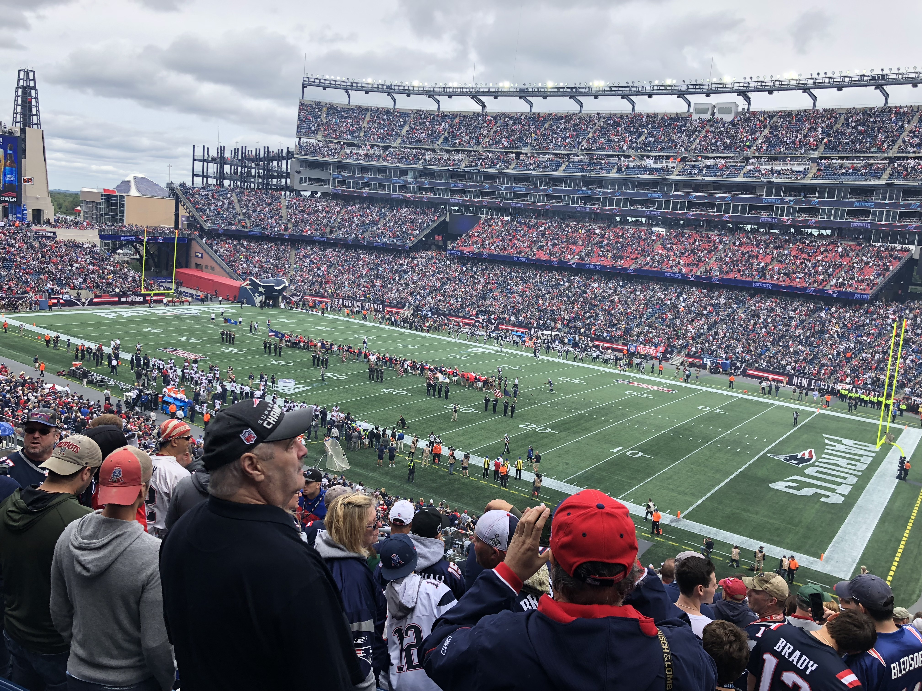
If your favorite team operated like your revenue cycle, would you have a winning team?
Copyright 2020 – All Rights Reserved

Slide 21
Comparison
Coaches coach but don’t play the game
            They empower the team to win the game
        Leaders coach but don’t direct or manage
        Managers direct but don’t coach
        The team is coached to success
        When there is a losing season, who gets fired – not the team
Copyright 2020 – All Rights Reserved

Slide 22
Leadership 101
A team will only follow someone they trust
  The leader must believe the team will do what is required of them
Must know how to do the job of the people they lead
Be friendly, but not a friend
Treat everyone equally– prevent favoritism
Praise publically, criticize privately – be aware of individual extra effort
  Feedback is not criticism and criticism is not feedback
Training process – see one, do one, teach one
Never be “too busy” for your team
“Stepping Stones of Leadership” by Jim Zelem pp 84-86
Copyright 2020 – All Rights Reserved

Slide 23
Overview
There needs to be a culture change, change in thinking
The people, the team will make you great if you give them the power
You don’t have to make them look great but what you do need to do is remove the obstacles, the bottlenecks – empower them
It’s not about you the leader, check your ego, it’s all about them
Copyright 2020 – All Rights Reserved

Slide 24
Teamwork 101
“When it comes to teamwork, there are lessons to be learned from the cockpit.
In air travel, when the captain first meets the crew, after making introductions, they align team goals and open channels of communication with everyone; they make it psychologically safe for even the most junior flight attendant to approach a senior captain about a potential safety issue and know that they will be heard.
We create among the team members a shared responsibility for the outcome of the flight, that it’s not only their right to speak up if they need to, it’s their responsibility to.
It’s not about who’s right, but what’s right.”
This is team empowerment, the essential ingredient to the success of any initiative.
Captain Sully Sullenberger – LinkedIn Post
Copyright 2020 – All Rights Reserved

Slide 25
What Is The Solution?
Holistic Team Empowerment
In a holistic solution each part contributes to the whole, yet no one part is more important that the whole.
How?
Establish the PROCESS

Slide 26

What’s Your Pain?
What’s Your Nail?
What Makes You Move off the Nail?
  When the pain enough?
  Or before the pain is TOO much?
Copyright 2020 – All Rights Reserved

Slide 27

What choices do you have when revenue is down?
Your service mix isn’t going to change
Your Payer mix is not changing
Where are you leaving money on the table?
How well do you manage your patient care?
Have you lost sight of what documentation really is?
Copyright 2020 – All Rights Reserved

Slide 28
Process
A process is a series of events leading to a desired result
What are you trying to accomplish?
Why?
What have you tried before?
What are your goals?
What are your indicators of success?
Copyright 2020 – All Rights Reserved

Slide 29
Structure
Leaders
Managers
Team
Copyright 2020 – All Rights Reserved

Slide 30
Structure
Leaders control process flow and are like a coach in a sports game, they are not in the trenches, nor play the game. They have a plan and give their teams direction and motivation to help them to reach their goals as they empower the team. They must ensure effective communication. remove the roadblocks, the workarounds, including the bottlenecks
Managers oversee and direct by planning, organizing, staffing, directing, and manage through utilizing human, financial, and material resources. They direct and don’t coach.
Teams when empowered will do the work, towards achieving the desired results and the level of accountability belongs with them and not the upper level
Copyright 2020 – All Rights Reserved

Slide 31
Step 1: Initiate a Gap Analysis:
  Identify the issue and who will manage it?
    How big is it?
  Typically the problems reside in your indirect costs process
    All components of UM 360 are indirect costs
  Focus on the positive, not the negative
  Determine your goal, your end point
Copyright 2020 – All Rights Reserved

Slide 32
Step 2: Find the Bottlenecks*
  Every process has them, leads to workarounds
  Your process is only as good as the throughput through your bottleneck
  Typically, with bottlenecks, shortcuts are taken
*”In …project management, a bottleneck is one process in a chain of processes, such that its limited capacity reduces the capacity of the whole chain…There are both short and long-term bottlenecks. Short-term bottlenecks are temporary and are not normally a significant problem…Long-term bottlenecks occur all the time and can cumulatively significantly slow down production.”
https://en.wikipedia.org/wiki/Bottleneck_(production)
Copyright 2020 – All Rights Reserved

Slide 33
The Toyota Way
Principle #5 – “Build a culture of stopping to fix problems, to get quality right the first time.”
In order to stop and fix a problem, you must first be able to identify a problem. We need to recognize a difference between a correct scenario and a problematic scenario
It’s not the supervisor that makes the line work, it’s the team that makes it work
  The synergy of the team is more important than the supervisor
  Think of the football team
  The supervisor must be able to take constructive criticism from the team
  They are in the trenches
Holism - No one person is any better than anyone else on the team
Copyright 2020 – All Rights Reserved

Slide 34
Step 3: Gather your data:
  No matter what the issue is to be researched, you must have benchmark data to start and for comparison
  Then establish a dashboard, helps prove value
  Gathering of data must be consistent, without variation; for example, every day at the same time depending on the issue
    Will facilitate areas to be addressed
  Again. identify areas of obstacles, work-arounds, and bottlenecks
Copyright 2020 – All Rights Reserved

Slide 35
Step 4: Work towards your goal(s):
  Establish your teams
    A team is a group of individuals working together to achieve their goal.
  Empower your teams
    Give them what they need to accomplish the goals
    Focus and reward based on outcomes, not tasks clicked off a list
Make sure that what is achieved matches your indicators of success.
Copyright 2020 – All Rights Reserved

Slide 36
Focus on Outcomes, Not Tasks
Ticking off tasks on our to-do lists might make us feel productive. But to truly be productive, we must clearly visualize the outcomes we want and design everything we do around getting them.
  Marcela Sapone

Slide 37
Two items you MUST have to achieve SUCCESS!
Standardization
  Is your process documented?
  Need consistency
  So people cannot change it – workaround
  Empower the team, not individuals
  Holism – the power of the team is more important than the people in the team
Accountability
  Listen to the team because they live with the game, management only lives with the results
  Push the accountability to the level it belongs – make the team accountable for the results
  Put them in the areas of their strengths, not their weaknesses
Without these you will likely fail
Copyright 2020 – All Rights Reserved

Slide 38
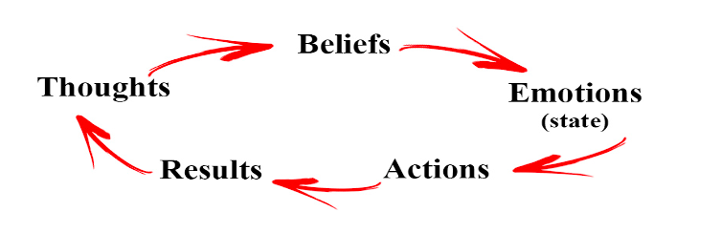
Positive vs. Negative
Copyright 2020 – All Rights Reserved

Slide 39
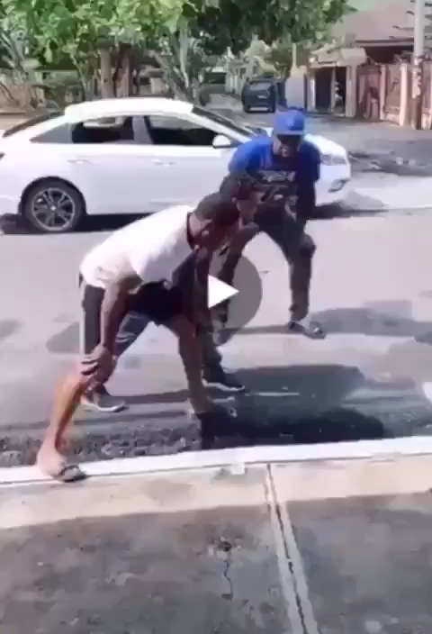
Communication Must be Effective

Slide 40
Step 5: Set SMART Goals
S – Strategic and Specific
M – Measurable
A – Attainable
R – Results-Oriented
T – Timebound
Copyright 2020 – All Rights Reserved

Slide 41
What Kind of Results Might You See with Integration?
Copyright 2020 – All Rights Reserved

Slide 42
Benefits of the Integration of Clinical Teams
Focus on useful documentation that best communicates patient care
Can accurately assess physician documentation to withstand scrutiny of oversight agencies and payers and reduce denials
Work in tandem with unified effort to improve quality and completeness of documentation
Produce a consolidated message focusing on the quality of the documentation, not necessarily the quantity
Reinforcers of “the message” with the On-site Physician Advisor to physicians and other clinical entities
Use of consolidated information platforms to improve efficiency and accuracy
Alignment of vision/mission- autocorrect past difficulties in mis-aligned functions
Acumen- capacity to interact accurately with depth of understanding across inter/intradisciplinary groups
Copyright 2020 – All Rights Reserved

Slide 43
How Do You Get Started?
Copyright 2020 – All Rights Reserved

Slide 44
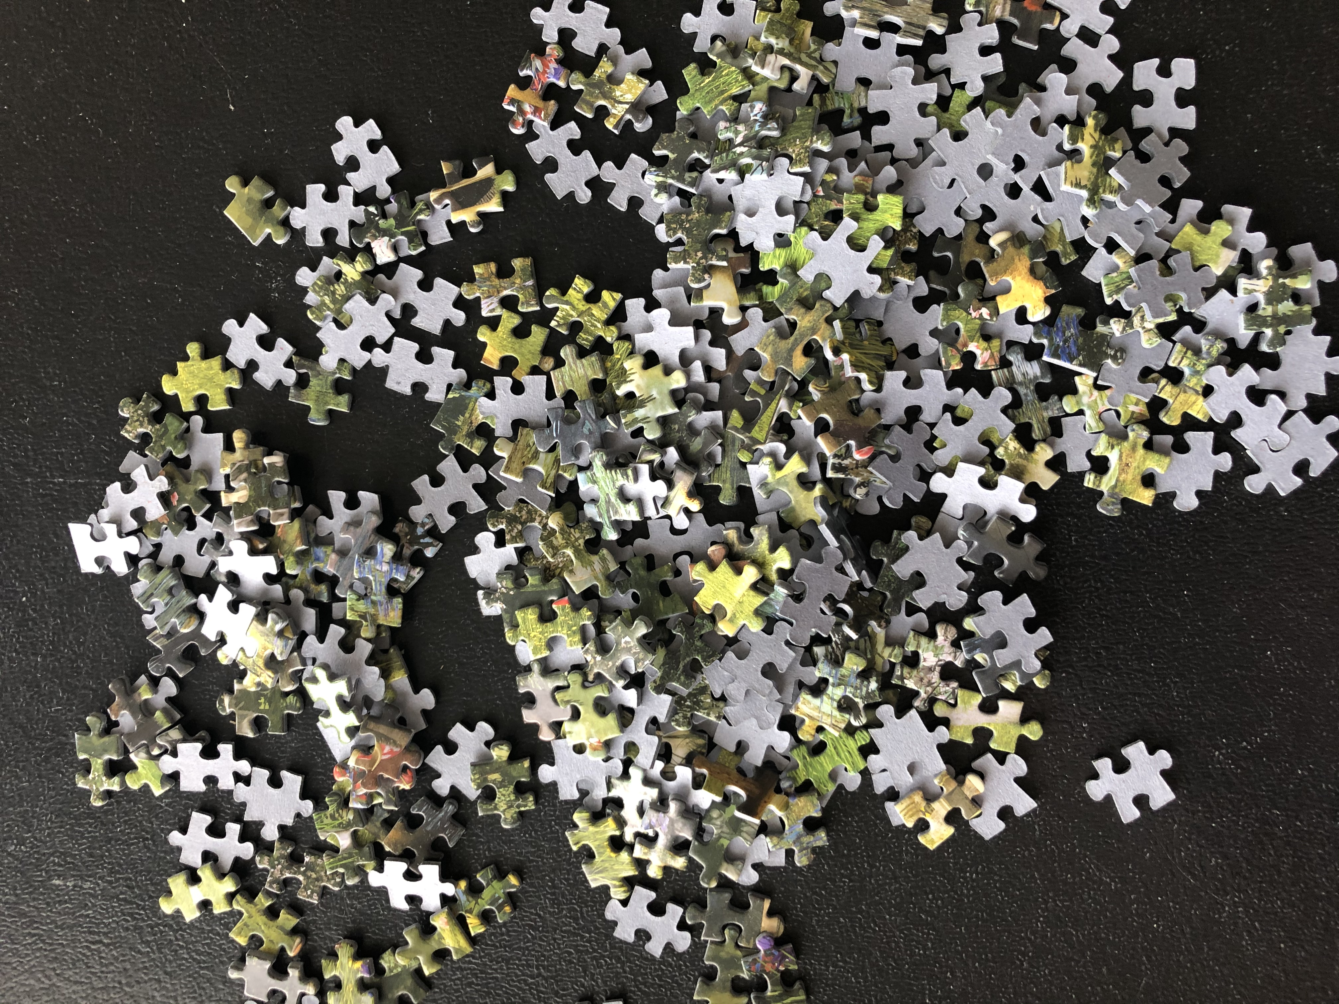
Implementation
May want to consider the puzzle analogy
How does one build a puzzle?
  The edges first
    Overall infrastructure, then build the components
  Place all the pieces on a surface
    Can be confusing and overwhelming
  Build sections at a time and incorporate into the whole
    Start with the simple to build the complex
    Holistic concept – each part affects the whole
    Ideal
Remember that DOCUMENTATION is the glue that holds it all together
Copyright 2020 – All Rights Reserved

Slide 45

Intermittent Reassessment
You now have your final picture, functioning process
Why reassess?
  There probably has been leadership changes
  There probably has been staffing changes
  Is the Education still consistent incorporating changes that have occurred in the industry?
  Is everyone following established protocol?
    Or have they picked a different seat (all at the same table concept)
  How do you measure success?
    Are you focusing on outcomes, not tasks?
Copyright 2020 – All Rights Reserved

Slide 46
Make It a YOUR Solution
Utilization Management 360 provides BEST PRACTICE solutions for each component of the clinical documentation continuum. With the proven success to bringing a holistic approach to the documentation continuum, Utilization Management 360 gives you the ability to identify the missing pieces in your current workflow. Once identified, Utilization Management 360 establishes a focused communication partnership between and within stakeholders of your documentation continuum and breaks down the silos impeding collaboration within your hospital. Utilization Management 360 builds on years of experience working with multidisciplinary teams and provides a Physician-led solution to your patient-centered clinical and financial strategies.
Copyright 2020 – All Rights Reserved

Slide 47
SLSC
Streamline Solutions Consulting, Inc. has the unparalleled ability to step back and objectively look at your organization; open your mind to different ways of doing and improving processes through gap analysis techniques while breaking down silos. Some of the following components define your processes and culture
Leadership
Community
Physicians
Staff
Documentation Improvement
Compliance and existing processes
Remember this: If you want to make some changes in your life, you need to make some changes
Copyright 2020 – All Rights Reserved

Slide 48
How Do You Get Started?
Contact us immediately for your complimentary evaluation
Copyright 2020 – All Rights Reserved

Slide 49
Copyright 2020 – All Rights Reserved

Slide 51
Contact Information
Dr. John Zelem, MD, FACS
Owner, Streamline Solutions Consulting
www.Streamlinesolutionsconsulting.com
john@streamlinesolutionsconsulting.com
(203) 231-0791
Glenn Krauss, Founder Core-CDI & Co-Founder Top Gun Audit School
Glenn.Krauss@Core-CDI
(603) 303-3337
www.Core-CDI.com
www.TopGunAuditSchool.com
Copyright 2020 – All Rights Reserved

