Slide 1

An Introduction to the
National Association of Healthcare Revenue Integrity

Slide 2
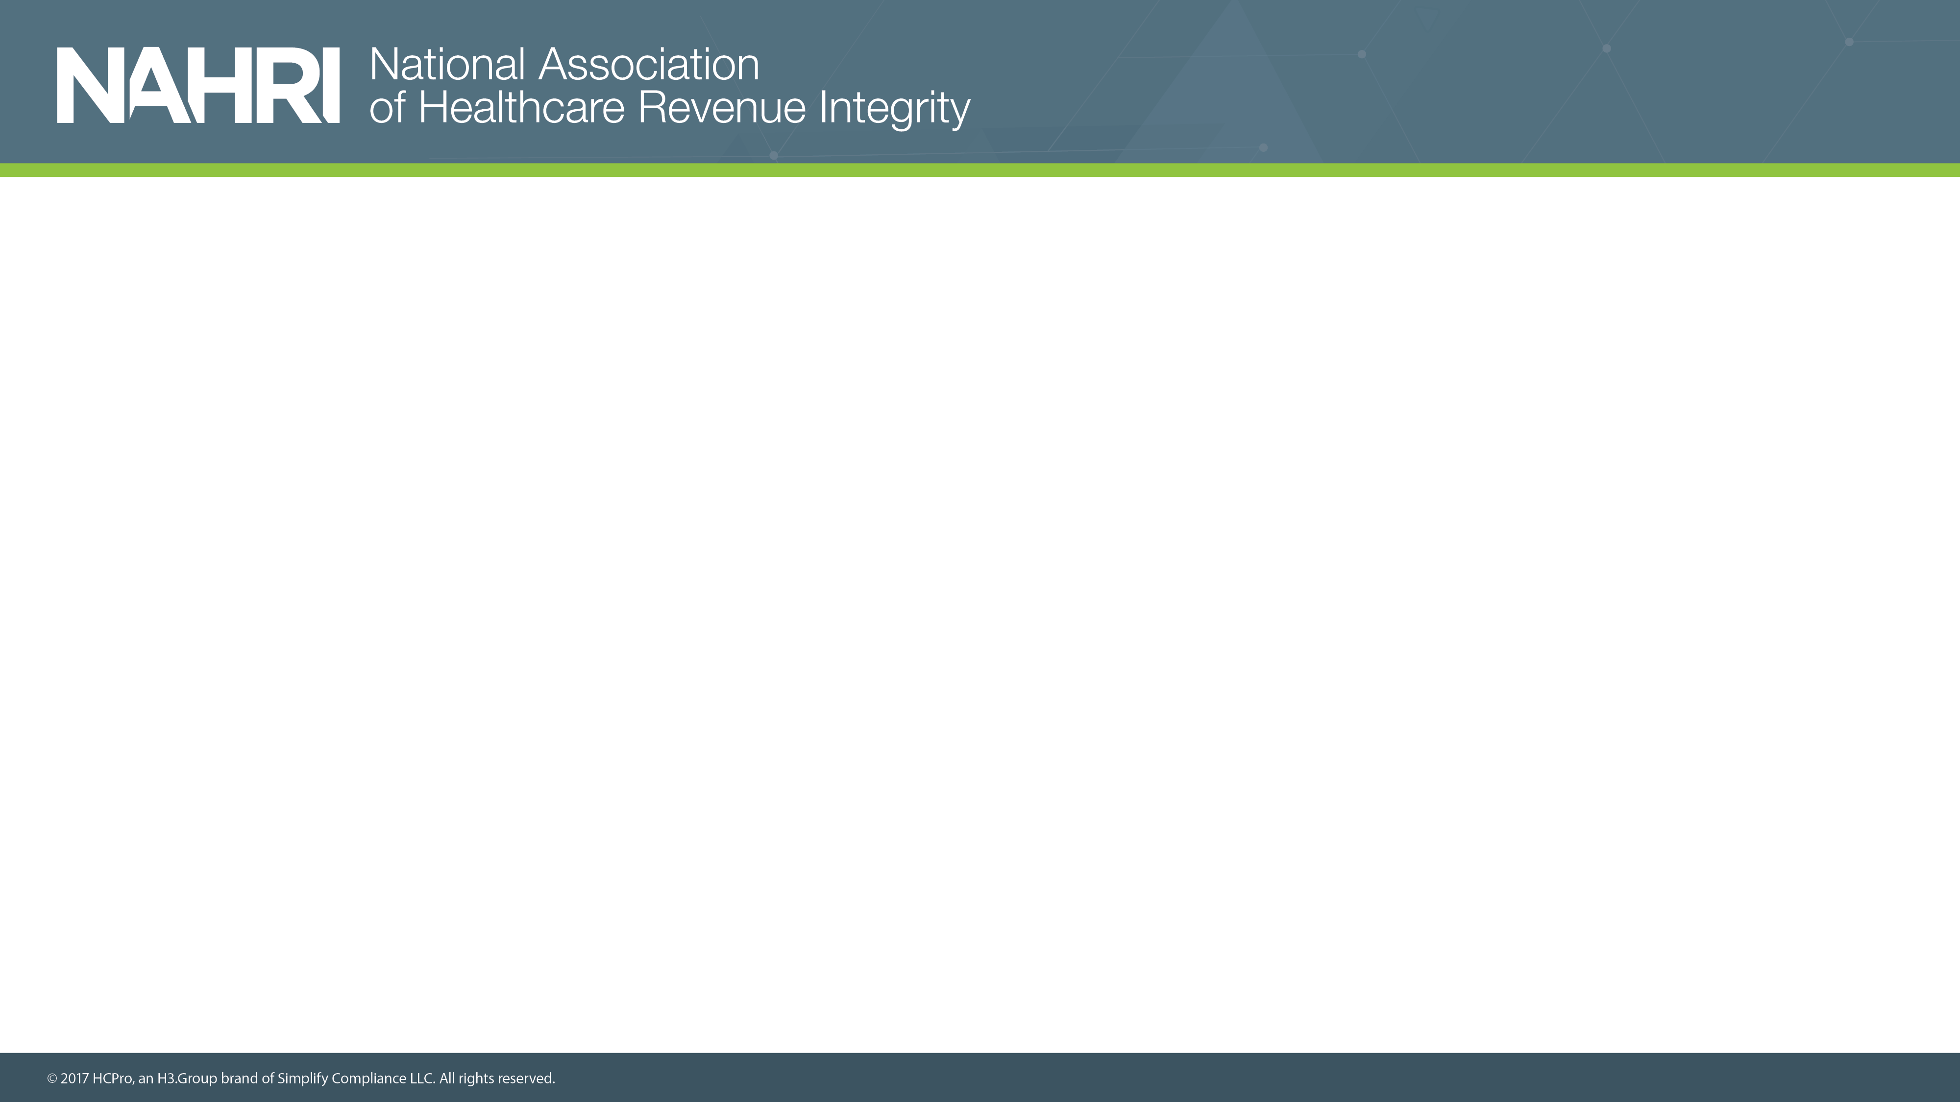
Presented by
Andrea Kraynak, CPC, NAHRI director
Jaclyn Fitzgerald, NAHRI associate director
Valerie Rinkle, MPA, NAHRI advisory board member and lead regulatory specialist and instructor at HCPro

Slide 3
Agenda
Introduction to NAHRI and its mission
Member benefits
Brief tour of the NAHRI website, including publications, resources, and forums
Discussion with Advisory Board Members
Up and coming benefits and programs coming in 2018

Slide 4
About NAHRI
NAHRI is the nation's only association dedicated to the revenue integrity profession. Members have access to articles, helpful forms and tools, networking events, special discounts, and much more.
NAHRI’s mission is to enhance the revenue integrity profession through standards, advocacy, networking, and the promotion of shared knowledge and resources.

Slide 5
Defining revenue integrity
  The basis of revenue integrity is to prevent recurrence of issues that can cause revenue leakage and/or compliance risks through effective, efficient, replicable processes and internal controls across the continuum of patient care, supported by the appropriate documentation and the application of sound financial practices that are able to withstand audits at any point in time.

Slide 6



Membership benefits
NAHRI members receive:
Advocacy and leadership from the NAHRI Advisory Board
Bi-Weekly tips, news, and strategies in our e-newsletter, Revenue Integrity Insider
In-depth news, analysis, and regulatory information, case studies on building successful
programs, and membership profiles in our quarterly journal, the NAHRI Journal
An opportunity to network with peers and colleagues in the NAHRI Forum
Access to live and archived quarterly conference calls, hour-long networking discussions, and more
Helpful tools accessed in our electronic Resource Library, including sample queries, policies, and tools
Access to the Revenue Cycle Career Center
Discounts to the annual Revenue Integrity Symposium, certification (coming soon!), and HCPro boot camps

Slide 7
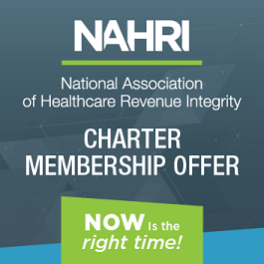

Charter Membership benefits
Save 20% by becoming a charter member!
Charter Members also receive a limited-time only welcome kit that includes:
Personalized membership card
NAHRI logo embossed journal
A complimentary copy of the Revenue Integrity Training Handbook, written by NAHRI board member Elizabeth Lamkin, MHA, ACHE
And a printed guide to your membership benefits
Become a charter member:
www.hcmarketplace.com/NAHRI or call 1-800-650-6787

Slide 8
Live website demonstration
www.nahri.org

Slide 9
Advisory Board Members
Catherine Boerner, JD, CHC, President, Boerner
Consulting, LLC
Sarah L. Goodman, MBA, CHCAF, CPC-H, CCP, FCS, President/CEO, SLG, Inc.
Ronald Hirsch, MD, FACP, CHCQM, Vice President,
R1 Physician Advisory Services
Elizabeth Lamkin, MHA, ACHE, CEO & Partner, PACE Healthcare Consulting, LLC
Kay Larsen Revenue Integrity Specialist, Glendale
Adventist Medical Center
Lisa Longo, CPC, CPC-I, Revenue Cycle Analyst,
Middlesex Hospital
Debbie Mackaman, RHIA, CPCO, CCDS, Regulatory
Specialist, HCPro
Debra May, Director Revenue Integrity, Renown Health
Terri Rinker, MT (ASCP), MHA, Revenue Cycle Director, Community Hospital Anderson
Valerie Rinkle, MPA, Regulatory Specialist, HCPro
Anna Santoro, MBA, CCS, CCS-P, RCC, System Director Revenue Integrity, CDM Hartford Healthcare
Donna Schneider, RN, MBA, CPHQ, CPC-P, CHC, CPCO, CHPC, System Revenue Compliance Officer, Yale New Haven Health
John D. Settlemyer, MBA, MHA, CPC, Associate VP Revenue Cycle, Carolinas HealthCare System
Jugna Shah, MPH, President, Nimitt Consulting, Inc.
Angela Lynne Simmons, CPA, VP, Revenue and Reimbursement, Vanderbilt University Medical Center
Diane G. Weiss, CPC, CPB, CCP, Vice President, Reimbursement, RestorixHealth
Denise Williams, RN, COC, Senior VP, Revenue Integrity Services, Revant Solutions

Slide 10
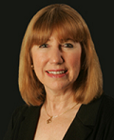
Advisory Board Member discussion
Valerie Rinkle, MPA, Regulatory Specialist, HCPro
Rinkle is a lead regulatory specialist and instructor in Middleton, Massachusetts, for HCPro's Revenue Integrity and Chargemaster Boot Camp as well as instructor for the Medicare Boot Camp®—Hospital Version, Medicare Boot Camp®—Utilization Review Version, and Medicare Boot Camp®—Critical Access Hospital Version. Rinkle is a former hospital revenue cycle director and has over 30 years of experience in the healthcare industry, including over 12 years of consulting experience in which she has spoken and advised on effective operational solutions for compliance with Medicare coverage, payment, and coding regulations.

Slide 11
Coming in 2018
Quarterly networking calls
  Tues, April 24, 2018 1:00 PM - 2:00 PM EDT
  Tues, July 31, 2018 1:00 PM - 2:00 PM EDT
  Tues, October 30, 2018 1:00 PM - 2:00 PM EDT
Revenue integrity credential
  Coming October 2018
Revenue Integrity Week
  June 3–9, 2018
Committees:
  Public policy committee
  Networking committee
  2019 conference committee
  Forms and tools committee

Slide 12
Coming in 2018
2018 Revenue Integrity Symposium—https://nahri.org/network/ris
  Location: The Wigwam Hotel
  300 East Wigwam Blvd.
  Litchfield Park (Phoenix), AZ 85340
  Main Conference: October 16–17
  Pre-Con Options
    Revenue Integrity Leadership Exchange: October 14–15
    Medicare Boot Camp - Utilization Review : October 14–15
  Post-Con Options
    Case Management Boot Camp: October 18–20
    Medicare Boot Camp - Provider-Based Departments Version: October 18–19

Slide 13

Questions?
Contact akraynak@nahri.org
Become a charter member:
www.hcmarketplace.com/NAHRI or call 1-800-650-6787

